Slide 1
Application Development with Kubernetes and AWS
Application Development with Kubernetes and AWS
Created by Shawn Zernik on 1/4/2024
Slide 1

Slide 2
Application Development with Kubernetes and AWS
Objectives
Provide history and evolution of computing and network environments.
Modern .NET Core application architecture
Containerization
Cloud environment setup
Application deployment
Created by Shawn Zernik on 1/4/2024
Slide 2

Slide 3
Application Development with Kubernetes and AWS
History & Evolution
Created by Shawn Zernik on 1/4/2024
Slide 3

Slide 4
History & Evolution
Centralized to Distributed to Centralized
Computing has evolved from single user single machine, to multiuser, to distributed, and is being consolidated back into data centers.
We had big single user machines that turned into big multiuser mainframes. This is where UNIX and Linux ultimately came from.
We then went distributed to everyone having a computer and a server on there local network.
We are not in a cycle of consolidating those servers back into data centers.
Created by Shawn Zernik on 1/4/2024
Slide 4

Slide 5
History & Evolution
The Latest Technology (1940’s)
In colloquial usage, the terms "Turing-complete" and "Turing-equivalent" are used to mean that any real-world general-purpose computer or computer language can approximately simulate the computational aspects of any other real-world general-purpose computer or computer language.
https://en.wikipedia.org/wiki/Turing_completeness
Emulation (1980’s)
Microsoft wrote BASIC on an 8080 emulator using a DEC PDP-8.
https://www.pbs.org/nerds/qa10.html
Created by Shawn Zernik on 1/4/2024
Slide 5

Slide 6
History & Evolution
Virtualization
Modern virtualization stems from emulation - we are effectively emulating the CPU and hardware the software runs on.
Most servers in classic bare metal models would only be utilized to 25%, 50%, but never up to 100% meaning the remaining utilized capacity is a waster of money, power, and resources.
Virtualization has the following benefits:
Better utilization approaching 100%
Separation and clear boundaries between software packages by no longer sharing operating systems
Abstracting the system from the hardware making moving to new hardware a simple file copy
Created by Shawn Zernik on 1/4/2024
Slide 6

Slide 7
History & Evolution
Virtualization - New Problem
Emulating all hardware is inefficient as computing cycles are used to provide the basic function of the hardware it’s self.
Solution
Hardware and software working together allows the guest system to use the underlying hardware to simulate and separate different ‘virtual computers.’ While this gives a good performance increase bringing the virtualized performance closer to the bare metal performance, it requires that the system being virtualized by compatible with the underlying hardware.
Created by Shawn Zernik on 1/4/2024
Slide 7

Slide 8
History & Evolution
Software Architecture
Software has changed with the internet and continued integration of systems and networks.
Service
Oriented
Architecture
Client
Server
Distributed
Systems
Monolith
Microservices
From
One
Machine
To
Millions
Personal
Computers
Mainframe
Networks
Servers
Internet
Virtualization
Cloud
Big
&
Heavy
Small
&
Light
Centralized
Decentralized
Global
Created by Shawn Zernik on 1/4/2024
Slide 8

Slide 9
History & Evolution
The Next Problem
Virtualization is heavy: we are running 1000s of operating systems; computing resources spent running the same operating system over and over; memory and disk space wasted; human effort to manage and orchestrate.
Solution
The solution started in the 1970’s in the UNIX world. A system called ‘chroot’ would isolate the filesystem. This isolation, also known as sandboxing, continued to sandboxing application execution space. This allowed applications to safely be separated from other applications for testing and security reasons in UNIX like environments.
Ultimately this led to containerization. Rather than virtualize the hardware and spin up another copy of the operating system, we can reuse parts of the operating system in a secure manner that looks like its own system.
https://www.opensourceforu.com/2016/07/many-approaches-sandboxing-linux/
https://medium.com/an-idea/a-brief-history-of-container-virtualization-57fc96c02924
Created by Shawn Zernik on 1/4/2024
Slide 9

Slide 10
History & Evolution
Physical to Containers
Below are the different hardware and software stacks of the different options:
Hardware
Hardware
Hardware
Operating OS
Operating OS
Operating System
Operating System
App
App
App
App
App
App
App
App
Operating OS
Operating OS
App
App
App
App
Bare Metal
Insecure
Inefficient
High Maintenance
Virtualization
Security
Resiliency
Better Utilization
Containerization
Security
Resiliency
Scalability
Created by Shawn Zernik on 1/4/2024
Slide 10

Slide 11
Application Development with Kubernetes and AWS
Technologies
Created by Shawn Zernik on 1/4/2024
Slide 11

Slide 12
Technologies
For the purposes of learning and testing out these new technologies, we are going to try to simulate and boot up an app in AWS using private networks.
Application
We will need an application to containerize. For this purpose, I wrote a simple .NET Core application.
Simple WebApi - provides HTTP endpoints for the UI
Entity Framework - used to provide data access
DacFx Project - allows DB control in GIT and drift protection during publishing
HTML / Javascript UI - a Web2.0 Javascript UI that calls the WebApi for data
Cloud Environment
To simulate a private corporate cloud environment, we have utilized:
AWS - the cloud provider
OpenVpn - provides direct access to the clouds VPC
RDS MS SQL - a fully managed MS SQL database instance
ECR - container registry for publishing to Kubernetes cluster
EKS - the Kubernetes cluster used
DevOps
For development and pipeline operations we have used the following:
GIT - repository to store code
Terraform - used to provision DB and Kubernetes
BASH - scripts used to build and deploy to AWS
VS Code - IDE of choice
Azure Data Studio - SQL client
SqlPackage - publish database changes
Created by Shawn Zernik on 1/4/2024
Slide 12

Slide 13
Application Development with Kubernetes and AWS
WebApi
(htown-msg)
Created by Shawn Zernik on 1/4/2024
Slide 13

Slide 14
WebApi Solution - Architecture
The application is referred to as “Houston Message Board”. It’s intended to be a simplistic stateful application that persists data to a Microsoft SQL database.
Client Side Server Side
Database Context Class
Web Browser
.NET
WebApplication
EndPoint Classes
Page.Html
Entity.Js
Page.Js
Entities
MS SQL
Response
There is no business logic layer here. Normally, between the end points and entities, there should be a business logic layer.
Created by Shawn Zernik on 1/4/2024
Slide 14

Slide 15
WebApi Solution – DotNet Commands
DotNet CLI
Traditionally, you would used Visual Studio to create and manage solutions and projects.
For .NET Core, considering it’s cross platform abilities and Visual Studio is limited to Windows, it provides a command line interface (CLI) that does the management of projects and solutions.
Create Solution
dotnet new sln --name "htown-msg"
Create Project
dotnet new web --framework net8.0 --language "C#" --name "webapi"
Add DacFx SQL Project
dotnet new -i Microsoft.Build.Sql.Templates
dotnet new sqlproj --target-platform "SqlAzureV12" --name "database"
Add Projects to Solution
dotnet sln htown-msg.sln add webapi
dotnet sln htown-msg.sln add database
Search for NuGet Packages
nuget search NAME
Add NuGet to Project
dotnet add "webapi.csproj" package Microsoft.Extensions.Logging.Console
Created by Shawn Zernik on 1/4/2024
Slide 15

Slide 16
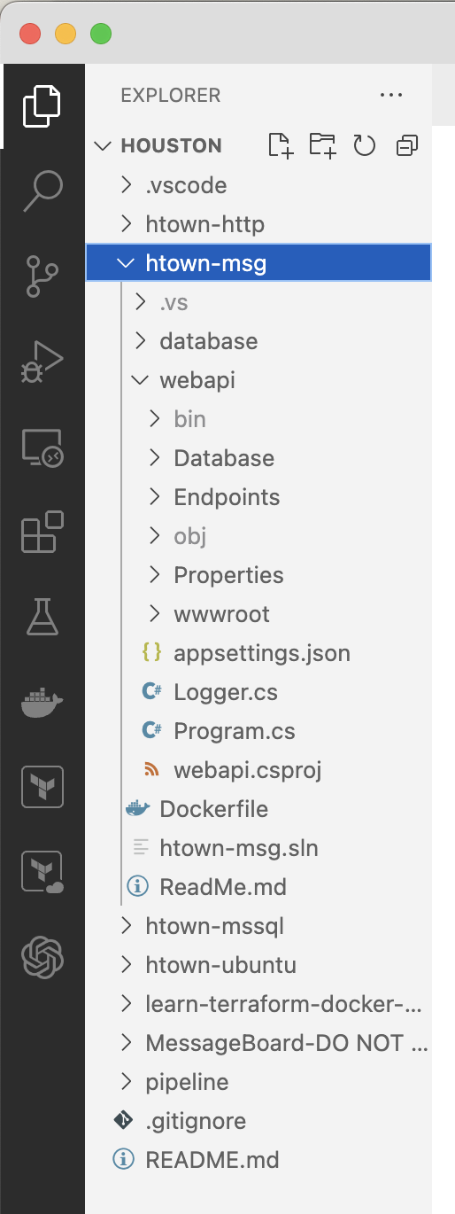
WebApi Solution – Folder Structure
Database Project
The application is broken down into the three components.
WebApi Project
wwwroot
Created by Shawn Zernik on 1/4/2024
Slide 16

Slide 17
Application Development with Kubernetes and AWS
Program
Created by Shawn Zernik on 1/4/2024
Slide 17

Slide 18
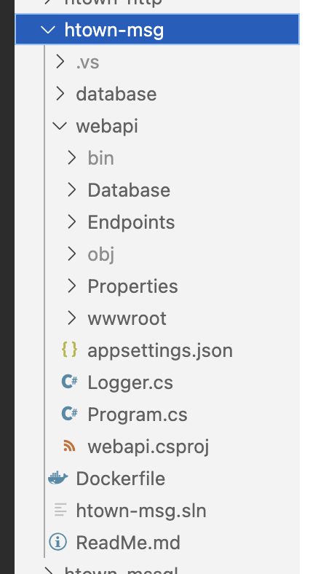
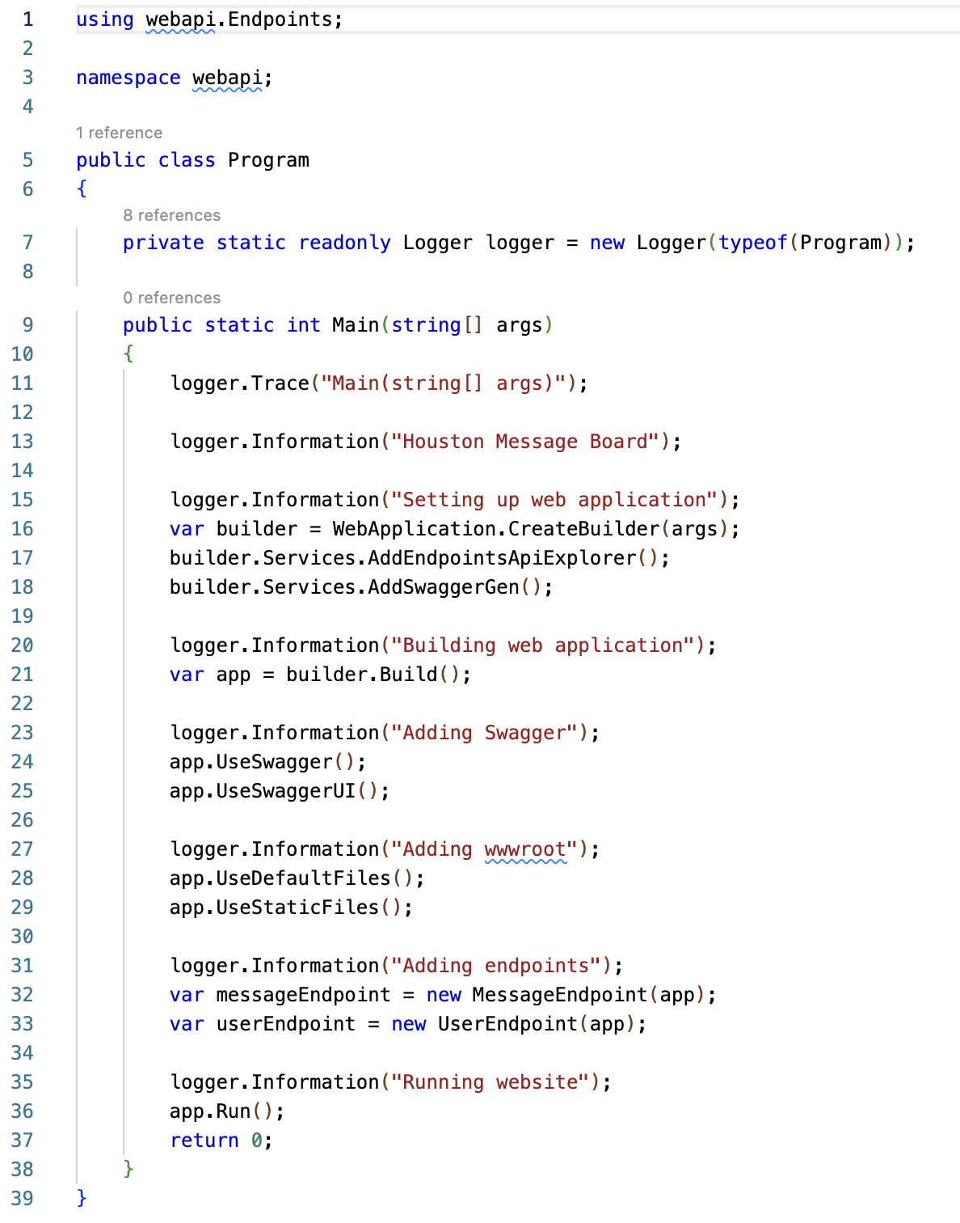
WebApi Solution – Program – Entry Point (main)
The boiler plate code provided was classless.
I inserted the Program class and Main() function.
Created by Shawn Zernik on 1/4/2024
Slide 18

Slide 19
WebApi Solution – Program – WebApplication
Sets up the basic HTTP server.
Created by Shawn Zernik on 1/4/2024
Slide 19

Slide 20
WebApi Solution – Program – Swagger
Swagger acts as a “PostMan” built directly into the web server.
Created by Shawn Zernik on 1/4/2024
Slide 20

Slide 21
WebApi Solution – Program – wwwroot (Static Content)
Add static HTML and JavaScript for user interface.
In a productionized application, static content would be served outside our container – some type of CDN.
We would have to account for CORS – cross origin resource sharing.
Created by Shawn Zernik on 1/4/2024
Slide 21

Slide 22
WebApi Solution – Program – End Points
Passes the web application to end point classes where they bind to URLs.
Created by Shawn Zernik on 1/4/2024
Slide 22

Slide 23
WebApi Solution – Program – Running
Starts the web server.
Created by Shawn Zernik on 1/4/2024
Slide 23

Slide 24
Application Development with Kubernetes and AWS
End Points
Created by Shawn Zernik on 1/4/2024
Slide 24

Slide 25
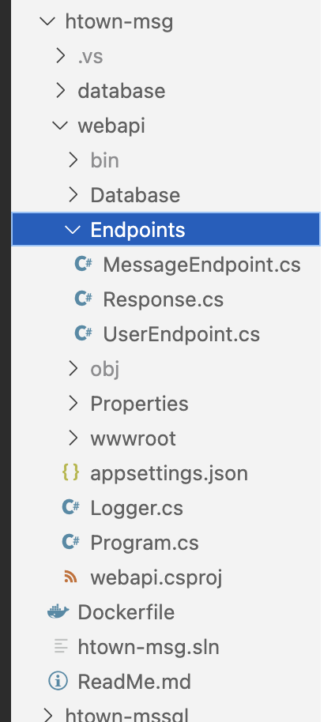
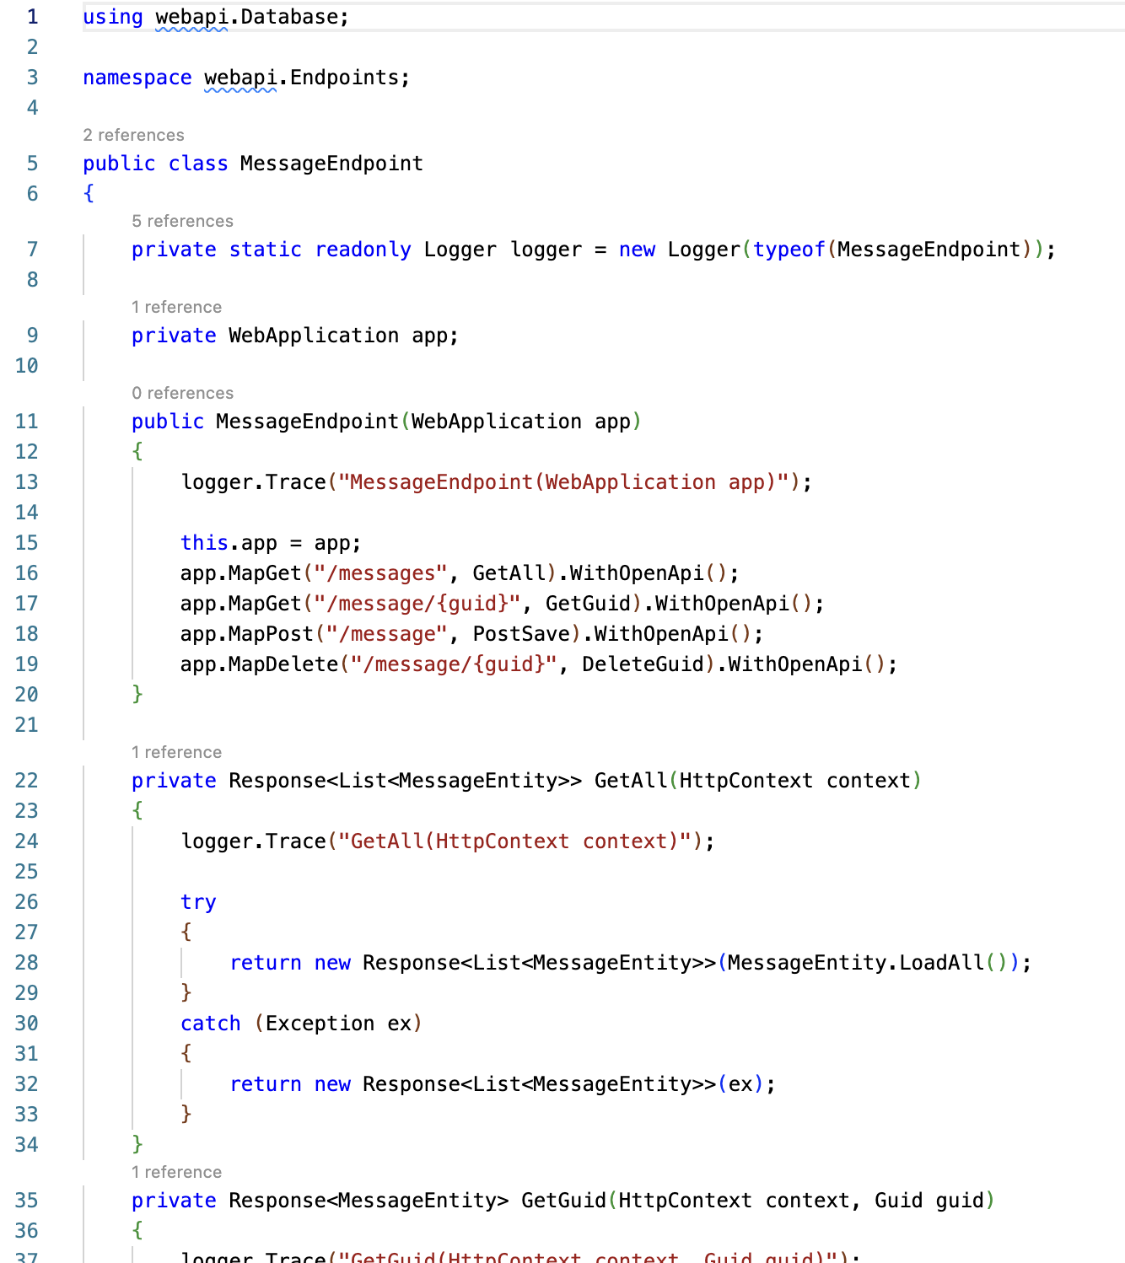
WebApi Solution – End Points – Routes
The constructor binds the end point URLs to member functions.
Map functions represent the HTTP methods the end point will respond to: GET, POST, PUT, DELETE, etc.
WithOpenApi registers the end point with Swagger.
We are also passing parameters in the URL such as {guid}.
Created by Shawn Zernik on 1/4/2024
Slide 25

Slide 26
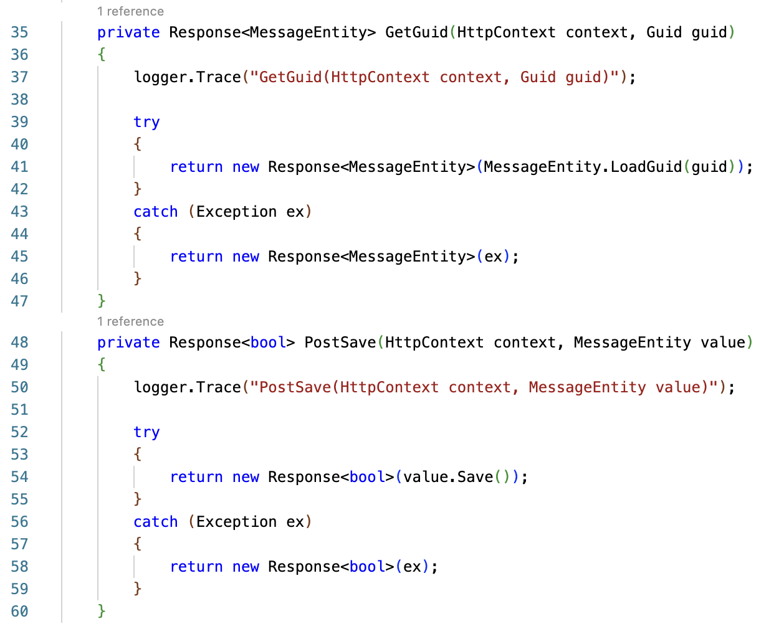
WebApi Solution – End Points – Parameters & Post Bodies
The URL parameter {guid} is being passed into the function.
The post JSON object is deserialized and passed into the function as well.
Created by Shawn Zernik on 1/4/2024
Slide 26

Slide 27
WebApi Solution – End Points – No Business Logic
WebApi end point should contain no business logic or data access.
This has been delegated to our entities.
Created by Shawn Zernik on 1/4/2024
Slide 27

Slide 28
WebApi Solution – End Points – Exception Handling
Exception handling has been added so the user does not get a 500 error if an exception is thrown by the application.
A response will always be returned.
Created by Shawn Zernik on 1/4/2024
Slide 28

Slide 29
Application Development with Kubernetes and AWS
Response
Created by Shawn Zernik on 1/4/2024
Slide 29

Slide 30
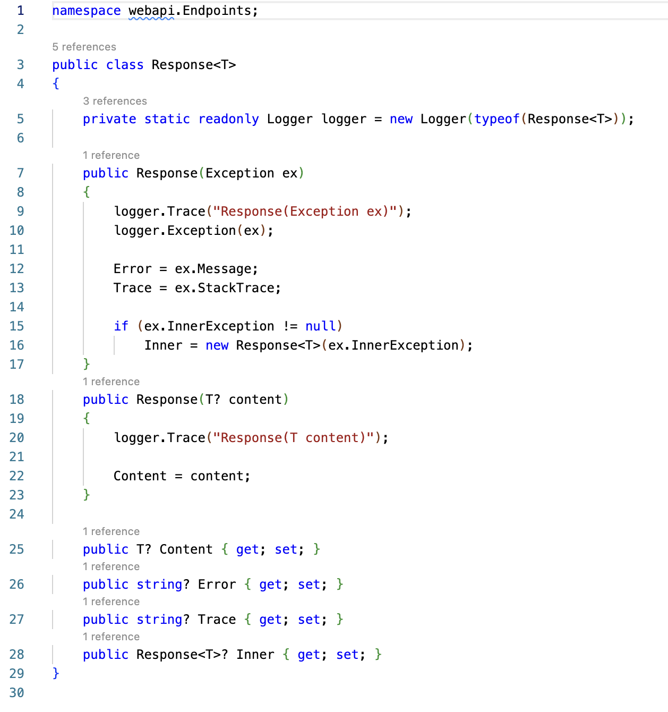
WebApi Solution – Response
When working with Simple WebApis, you can return an object to become the JSON response.
The problem is if an error occurs and an unhandled exception if thrown, the user gets a nasty 500.
We created a generic response object to allow errors/exceptions to be returned to the UI.
Created by Shawn Zernik on 1/4/2024
Slide 30

Slide 31
WebApi Solution – Response
This will be serialized to JSON:
{
content: { … json_object_t … }
error: null
trace: null
inner: { … nested_responses …}
}
Created by Shawn Zernik on 1/4/2024
Slide 31

Slide 32
WebApi Solution – End Points – Success
When we construct a response with object of generic type T, it will populate the “content” property.
Created by Shawn Zernik on 1/4/2024
Slide 32

Slide 33
WebApi Solution – End Points – Exceptions
When we construct a response with an exception, it will capture the error and nested exceptions for the UI.
In a public facing internet site, this is considered insecure.
Created by Shawn Zernik on 1/4/2024
Slide 33

Slide 34
Application Development with Kubernetes and AWS
Entities (EF8)
Created by Shawn Zernik on 1/4/2024
Slide 34

Slide 35
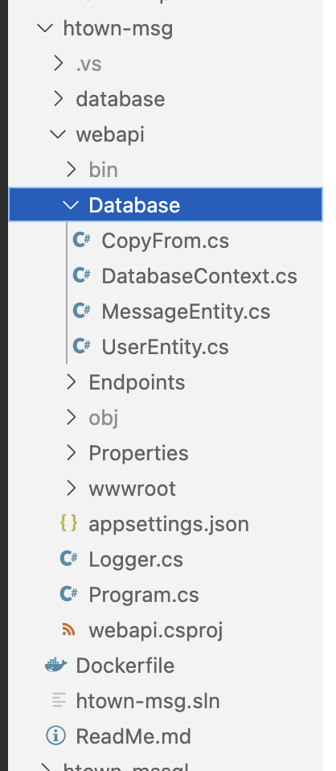
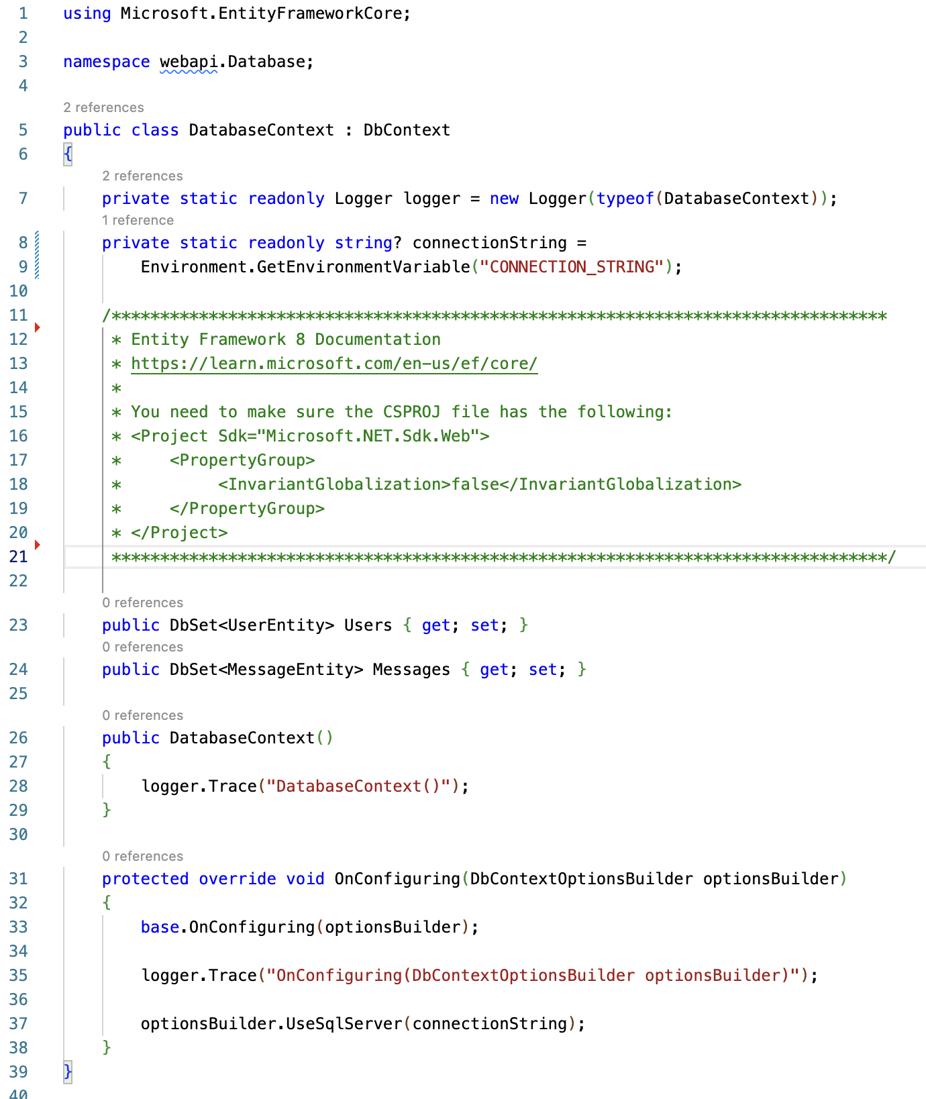
WebApi Solution – Entities
Entity Framework 8
These should have no business logic but should only have data access.
We would expect to see a series of classes for business logic separate from our EF classes.
Examples of business logic would be validating inputs, and/or calculating invoices and taxes.
This application is devoid of business logic.
Created by Shawn Zernik on 1/4/2024
Slide 35

Slide 36
WebApi Solution – Entities - Globalization
Entity Framework 8
If you include EF8, you need to change the “InvariantGlobalization” otherwise your SQL connection will fail.
Created by Shawn Zernik on 1/4/2024
Slide 36

Slide 37
WebApi Solution – Entities – Context
To setup EF8, we need a DbContext class.
This is responsible for the DB connection and tracking the tables it works with.
The context is your starting point for database and table access.
Created by Shawn Zernik on 1/4/2024
Slide 37

Slide 38
WebApi Solution – Entities – Connection
You need to configure your connection string to the database.
Using 12 factor principals, all configuration values should come from the environment.
https://12factor.net/
Created by Shawn Zernik on 1/4/2024
Slide 38

Slide 39
WebApi Solution – Entities – Linking Context to Entities
Each table and entity combination needs to be added to the DbContext.
This allows programmatic access to the entities and table from the context and registers then with the context.
Created by Shawn Zernik on 1/4/2024
Slide 39

Slide 40
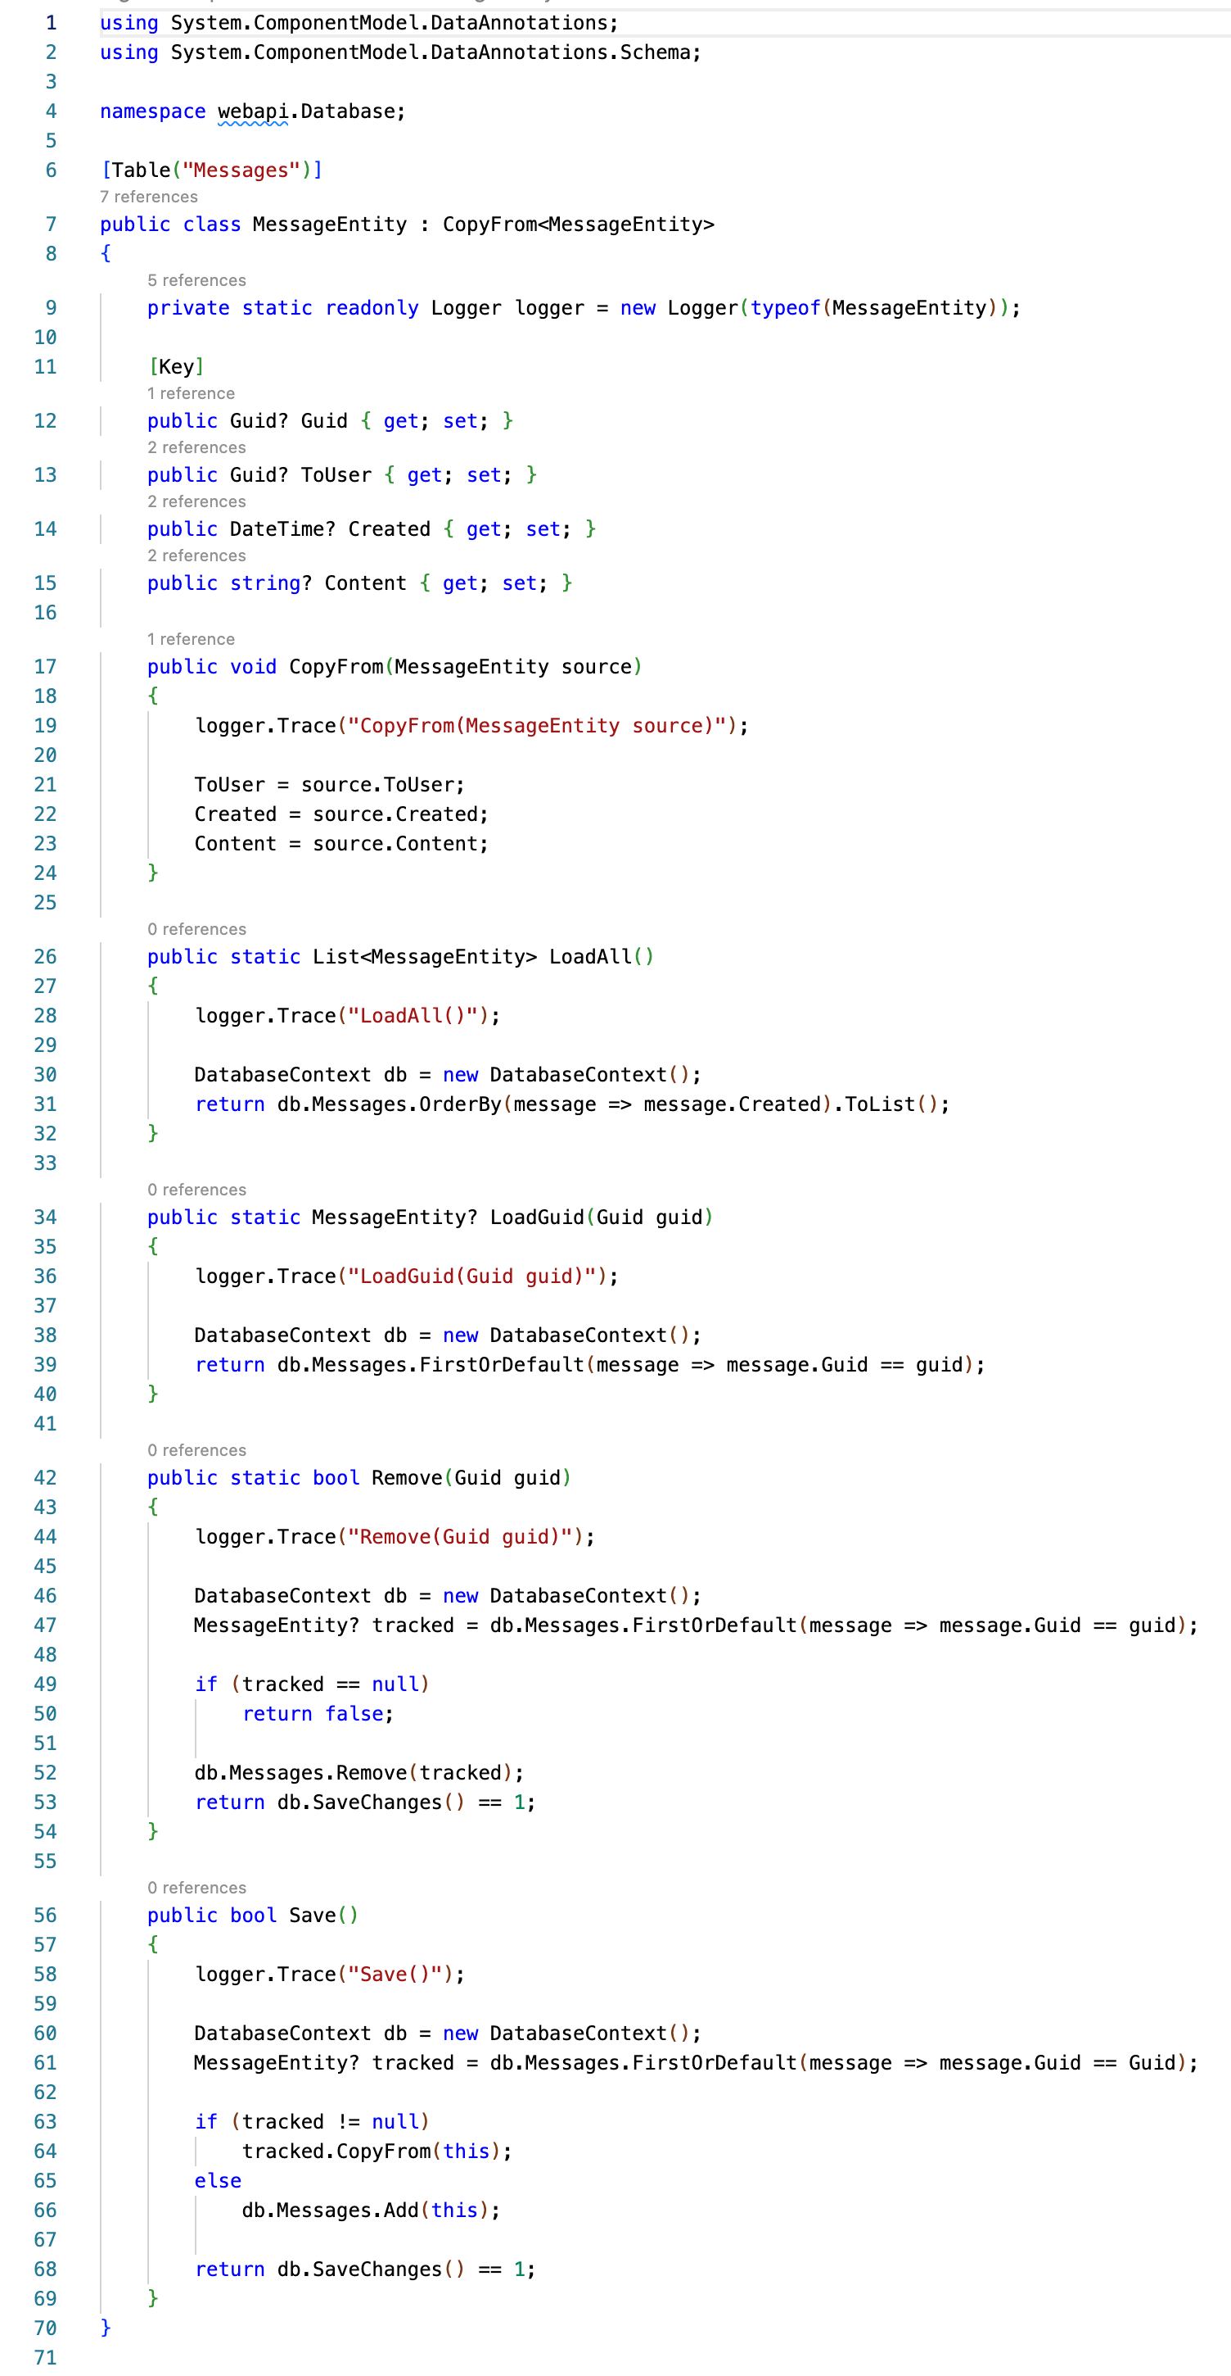
WebApi Solution – Entities – Entity – Implementation
The “Table” annotation is not required if you follow EF8 naming patterns.
I’ve included it to highlight the syntax required when needed.
Created by Shawn Zernik on 1/4/2024
Slide 40

Slide 41
WebApi Solution – Entities – Entity – Primary Keys
When not following common practices – where you “ID” column is a autoincrement big integer, you must annotate the “Key” column.
This is why the “Key” annotation is here – I preffer to use GUIDs as primary keys. I can predict them before inserts.
Created by Shawn Zernik on 1/4/2024
Slide 41

Slide 42
WebApi Solution – Entities – Entity – Untracked
If an entity is not loaded/created directly from the DbContext – it’s “untracked”.
You cannot use the DbContext to persist those entities.
To handle the case where the WebApi gets an entity in the post body and we need to save or update it, I’ve created the “CopyFrom” interface that copies the fields between entities.
Created by Shawn Zernik on 1/4/2024
Slide 42

Slide 43
WebApi Solution – Entities – Entity – Static Data Operations
Loading an entity, or deleting an entity by primary key, we would not have an instance of that entities class.
These data operations are static functions on those entities.
Created by Shawn Zernik on 1/4/2024
Slide 43

Slide 44
WebApi Solution – Entities – Entity – Instance Data Operations
If we have an instance of an entity loaded, the save was implemented using a member instance method.
Created by Shawn Zernik on 1/4/2024
Slide 44

Slide 45
WebApi Solution – Entities – Entity – No Business Logic
Your database entities should not have any business logic.
Keep this strictly data access.
If you need to introduce business logic, you’ll want to use another class for that.
class EntityBizLogic<T> {
EntityBizLogic(T entity);
calculate();
validate();
}
Consult your architect for patterns you should use.
Created by Shawn Zernik on 1/4/2024
Slide 45

Slide 46
Application Development with Kubernetes and AWS
Database Project
(DacFx)
Created by Shawn Zernik on 1/4/2024
Slide 46

Slide 47
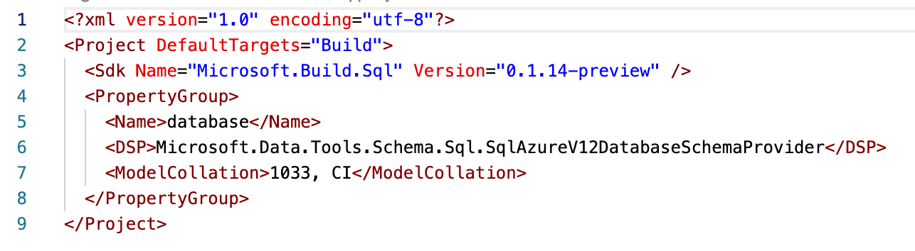
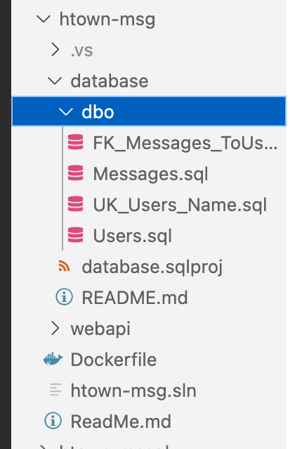
Database Project – Target Server Version
The DotNet CLI will create the ”.sqlproj” file for you.
The critical line to note here is the “<DSP>” as this specifies the target database.
Using Visual Studio can “reverse engineer” a database project for you. Ours was created from scratch.
Created by Shawn Zernik on 1/4/2024
Slide 47

Slide 48
Database Project – File Organization
Common practice is to create a folder for the “schema” – in this case it’s the default schema “dbo”.
Under the schema folder it’s common to create a folder for each SQL objectr type: tables, storedprocs, triggers, functions, etc.
Created by Shawn Zernik on 1/4/2024
Slide 48

Slide 49
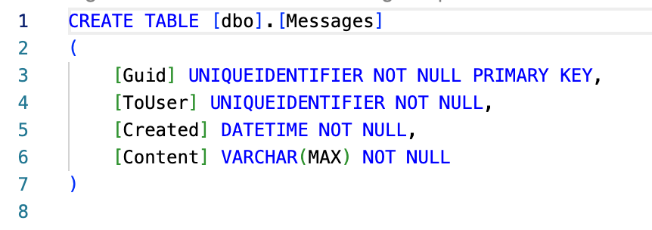
Database Project – SQL Scripts
We will add our tables using standard data definition language (DDL).
When we want to add a new column, you do not write an “ALTER TABLE” query, but instead can update the existing “CREATE TABLE”.
DacFx will do all the magic for you.
Created by Shawn Zernik on 1/4/2024
Slide 49

Slide 50
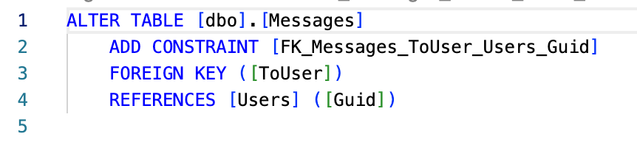
Database Project – Single or Multiple Files
You can combine multiple queries into one SQL. It’s common to separate queries out by SQL object type.
This is an example of the foreign key object.
Created by Shawn Zernik on 1/4/2024
Slide 50

Slide 51
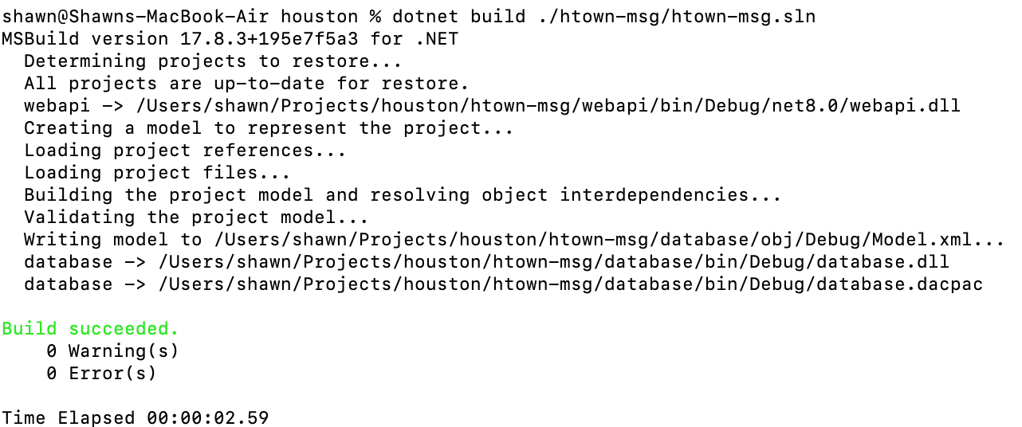
Building the Solution – VS Code
An DacFx project (aka “sqlproj”) will have an artifact of “.dacpac”.
This contains all the database information based on the compiled SQL scripts.
This ”.dacpac” will be used to determine the changes needed to be made on the target database so it matches the definition in the “.dacpac” file.
More to come on that once we get MS SQL running in a container.
Created by Shawn Zernik on 1/4/2024
Slide 51

Slide 52
Application Development with Kubernetes and AWS
Building the Solution
Created by Shawn Zernik on 1/4/2024
Slide 52

Slide 53
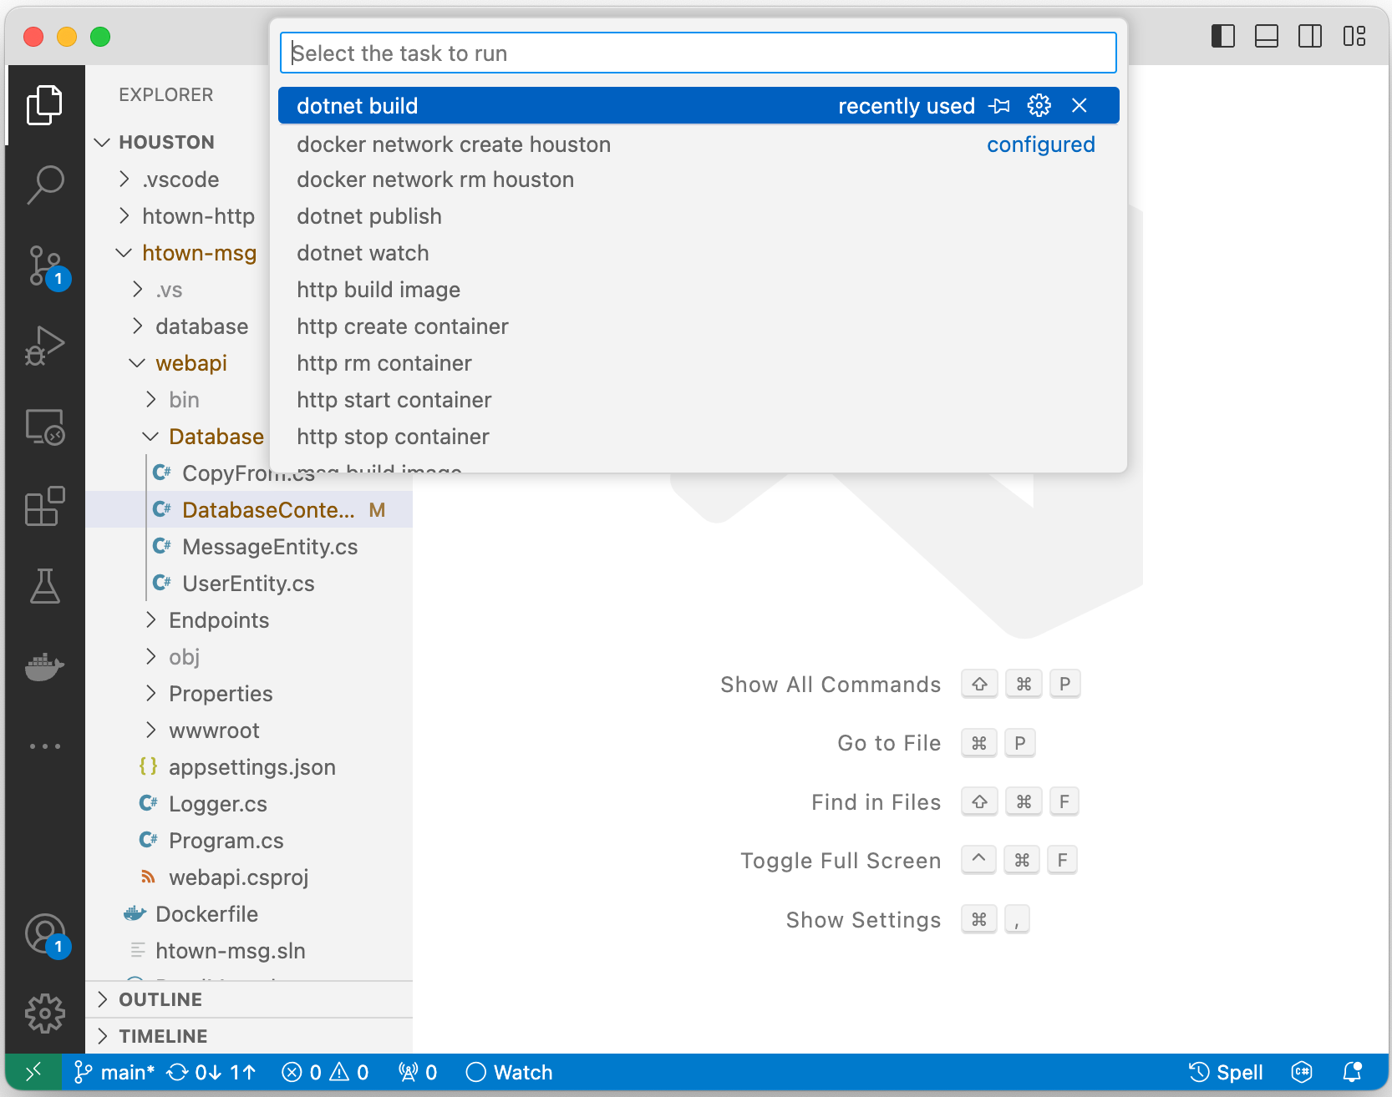
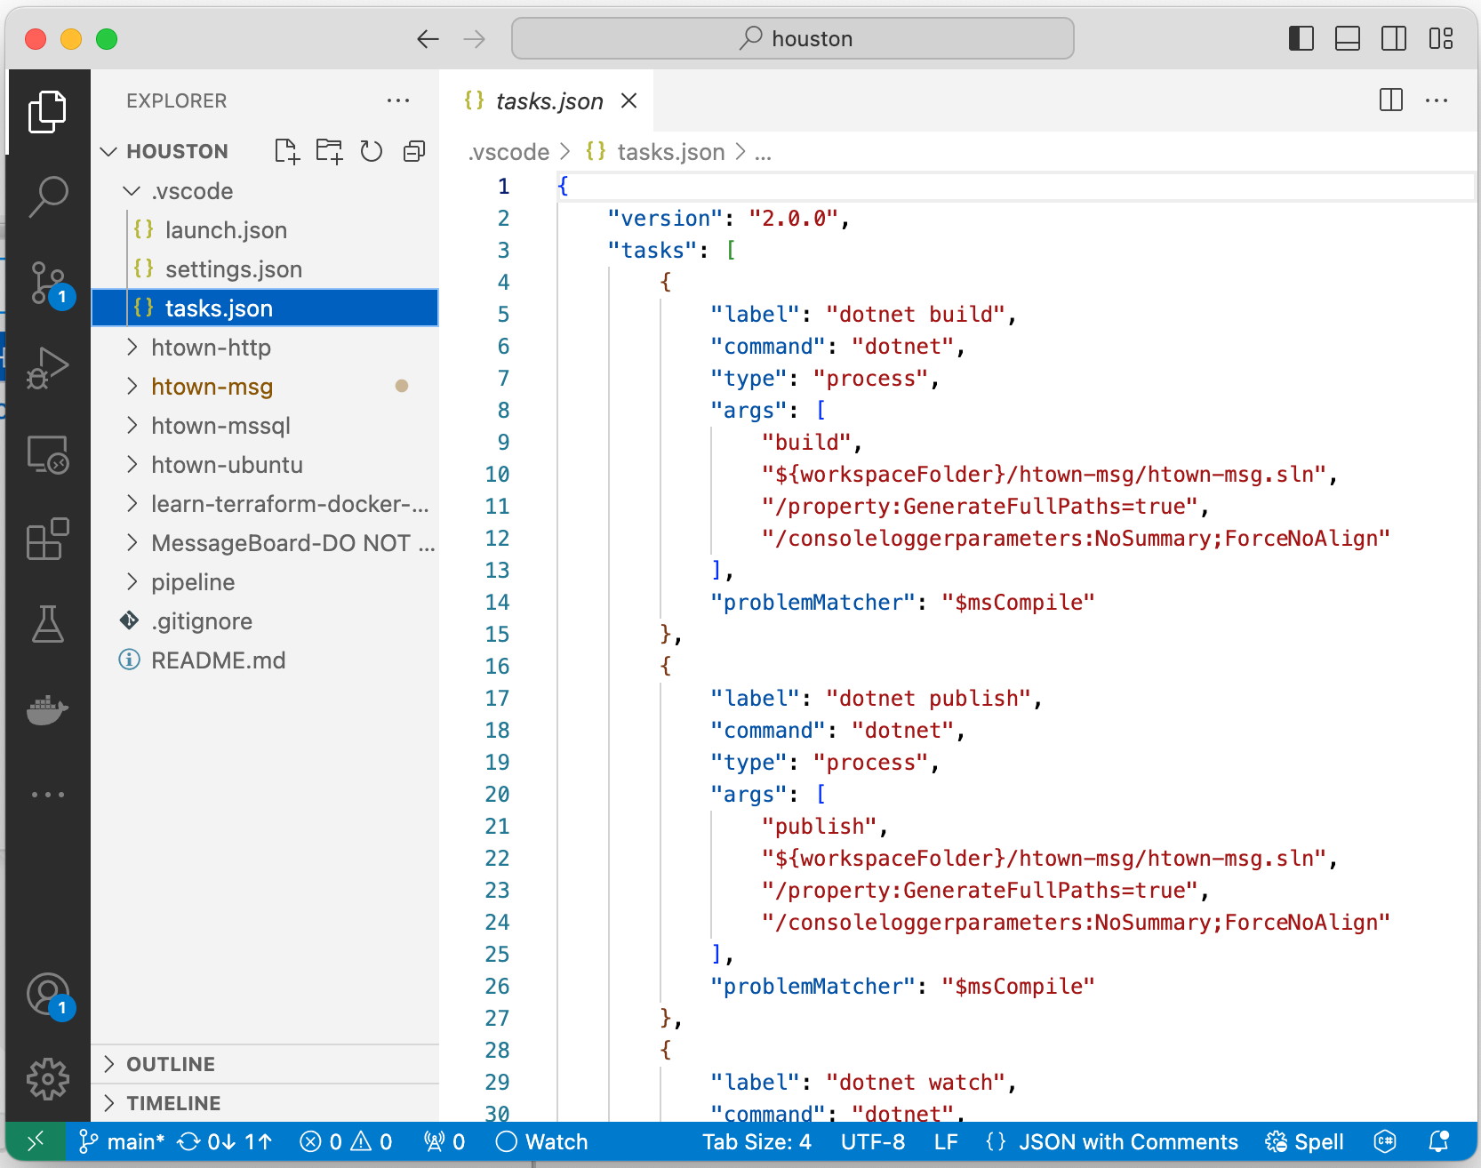
Building the Solution – VS Code
Shift – Command - T
The tasks are defined in the workspaces folder:
${workspace}\.vscode\tasks.json
Created by Shawn Zernik on 1/4/2024
Slide 53

Slide 54
Building the Solution – VS Code
Being able to do everything at the command prompt is critical – this is what you’ll need to know for setting up the pipeline.
dotnet build ${workspace}\htown-msg\htown-msg.sln
Should give the following output:
Note the artifact locations in the build output.
You can build a “csproj” or “sqlproj” directly.
Also note that a “build” will not package the “wwwroot” with the ”webapi” project. You need to “publish” for that.
Created by Shawn Zernik on 1/4/2024
Slide 54

Slide 55
Application Development with Kubernetes and AWS
Docker Containerization
Created by Shawn Zernik on 1/4/2024
Slide 55

Slide 56
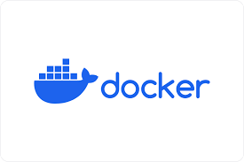

Containerization – Docker vs Podman
For getting some basic understanding of containerization, we will start simple and then get more complicated. The following folders have steps to walk through containerization.
When refering to containerization, the choice of docker or pacman is indifferent and pacman uses the same parameters and syntax a docker. Simple replace docker with pacman:
docker ps -a
pacman ps -a
(licenses required for commercial use)
(free & opensource)
Created by Shawn Zernik on 1/4/2024
Slide 56

Slide 57

Containerization – podman’s DNS Issue
Our client is using podman rather than docker. When setting podman up on the client's laptop, I was not able to pull images. This is because the WSL image used is using an invalid DNS server.
Start > Type “WSL” and click the penguin head
At the linux command prompt:
  cd /etc
  cat resolve.conf
  Look at the “nameserver” line. If the server is invalid, you will need to edit the file and set a valid name server.
Created by Shawn Zernik on 1/4/2024
Slide 57

Slide 58
Application Development with Kubernetes and AWS
Networking
Created by Shawn Zernik on 1/4/2024
Slide 58

Slide 59
Containerization – Networking
The following is a conceptualized container runtime environment.
The key here to understand is that containers are isolated on there own network that cannot talk to your local computer.
You need to do “port forwarding” to allow access into the docket containers.
Container Runtime
Default Network
*When using a database inside a container, you need to mount persistent storage for the LDF and MDB file. Otherwise, when your container is deleted, your data is lost.
If you do not specify a network for your container, it’s added to the default.
Web Browser
Port Forwarding
8080 → 80
Houston Network
WebApi
MS SQL*
wwwroot
Persistent
Volume
SSMS
/
Azure Data Studio
Port Forwarding
1433 → 1433
Created by Shawn Zernik on 1/4/2024
Slide 59

Slide 60
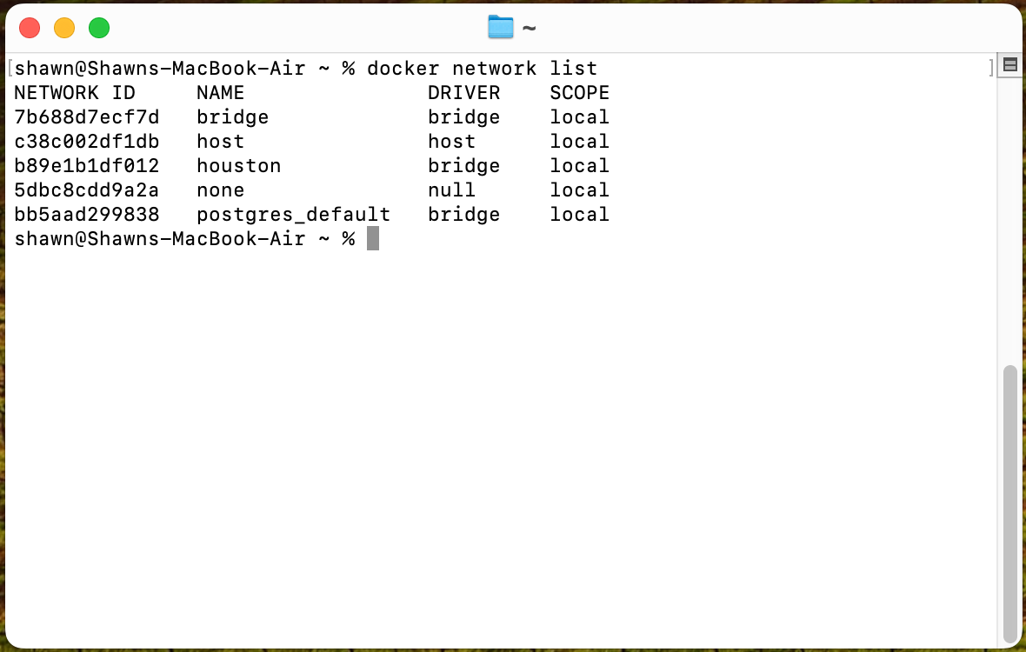
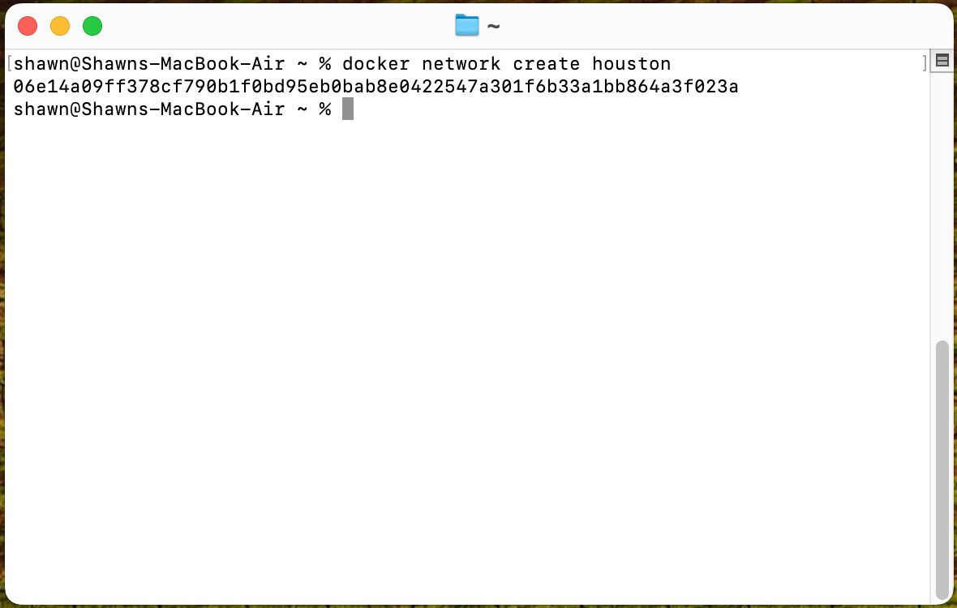
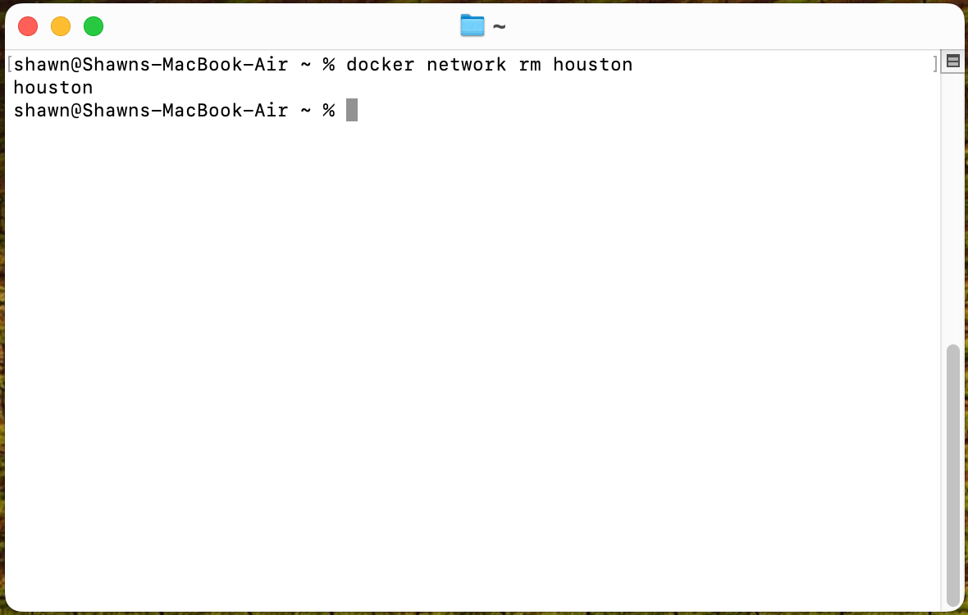
Containerization – Network Administration
For the next steps, we will explore containers and networking. First, we will discuss networking and then containers. Again, when we don’t specify a network, container engine will use the “default” network. For most instances, we will want to isolate our applications and workload on their own network.
List Network
docker network list
The network type we typically use is “bridge”. Bridge is a fancy network term for router, and for our routing, we’ll use NAT.
Create Network
docker network create houston
If we don’t specify a network type, it’ll give us a bridge. The output on success is a big long SHA hash. When referencing by hash, you must only type the first part to the point of uniqueness - otherwise you’ll target many hashes.
Delete Network
docker network rm houston
This will delete the network named “Houston”. The output on success is simply the network name.
Created by Shawn Zernik on 1/4/2024
Slide 60

Slide 61
Application Development with Kubernetes and AWS
Standard Images
Created by Shawn Zernik on 1/4/2024
Slide 61

Slide 62
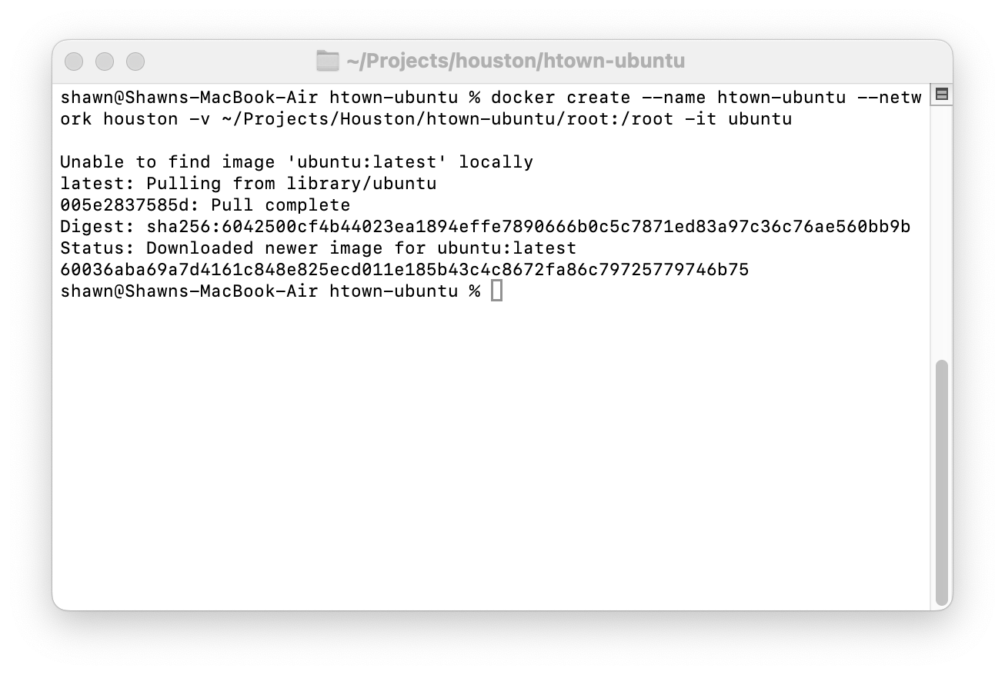
Containerization – Ubuntu Image - Create
Next, we will create an ubuntu container from the standard ubuntu image. This container will map the “/root” folder to a location on your drive.
Create Container
docker create \
--name htown-ubuntu \
--network houston \
-v ~/Projects/Houston/htown-ubuntu/root:/root \
-i \
-t \
ubuntu
Parameters
create – tells docker to create a container
--name – name of the container
--network – network to attach the image to
-v – mount local folder to a path inside of counter
-i – interactive
-t – use tty (terminal / console)
ubuntu – image to use
Created by Shawn Zernik on 1/4/2024
Slide 62

Slide 63
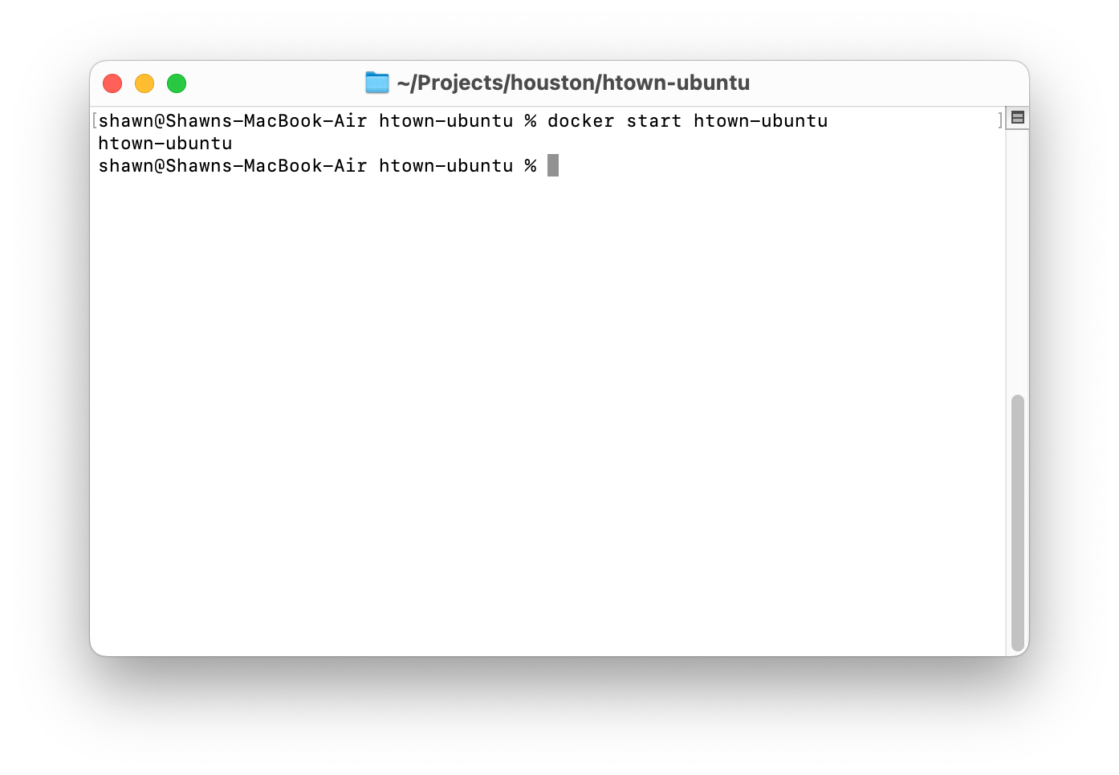
Containerization – Ubuntu Image - Start
Once we have a container, we can start it.
Start Container
docker start htown-ubuntu
Parameters
start – indicates to start a container
htown-ubuntu – name of the counter to start
On success, it lists the containers name.
Created by Shawn Zernik on 1/4/2024
Slide 63

Slide 64
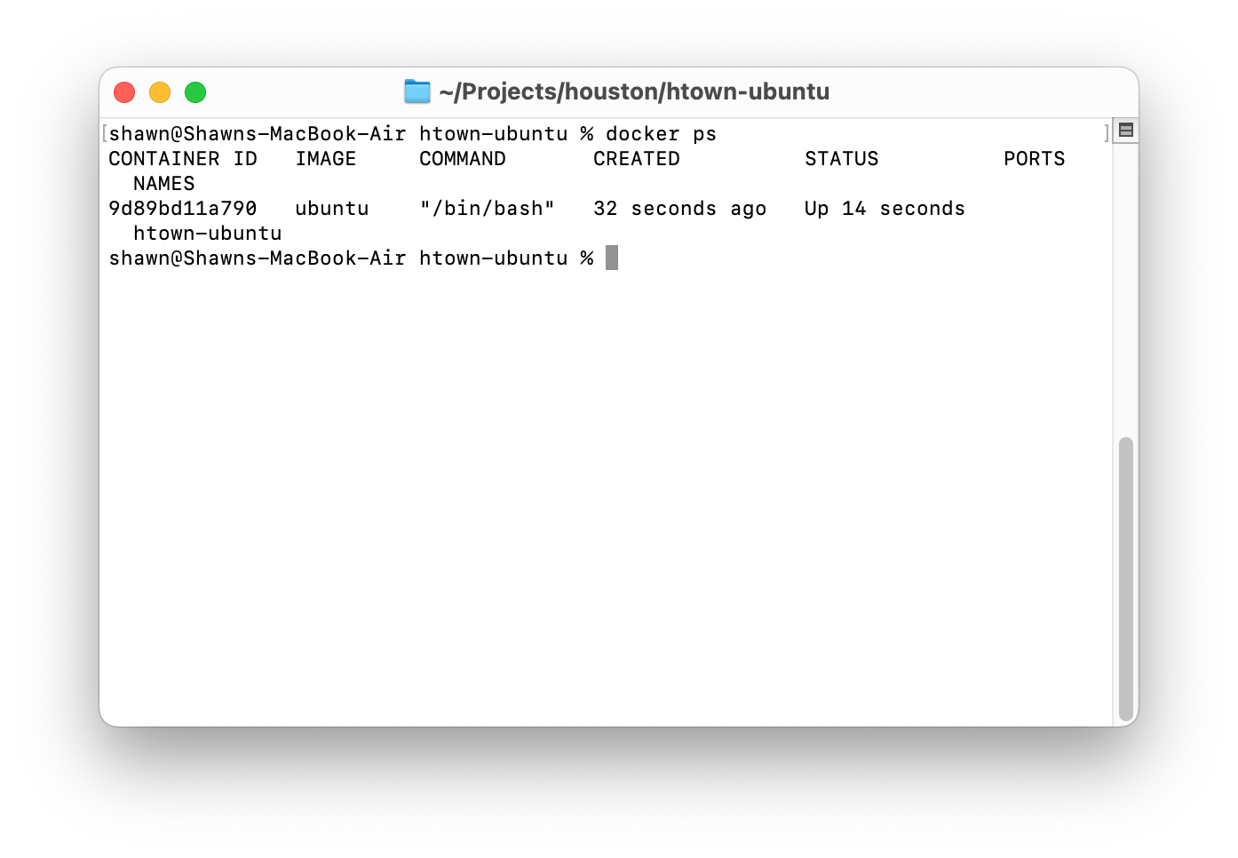
Containerization – Ubuntu Image – List Running
To see the containers running, we can use the “ps” command. Think “ps” like the linux command – it lists what’s running.
List Running Containers
docker ps
Parameters
ps – print status
Created by Shawn Zernik on 1/4/2024
Slide 64

Slide 65
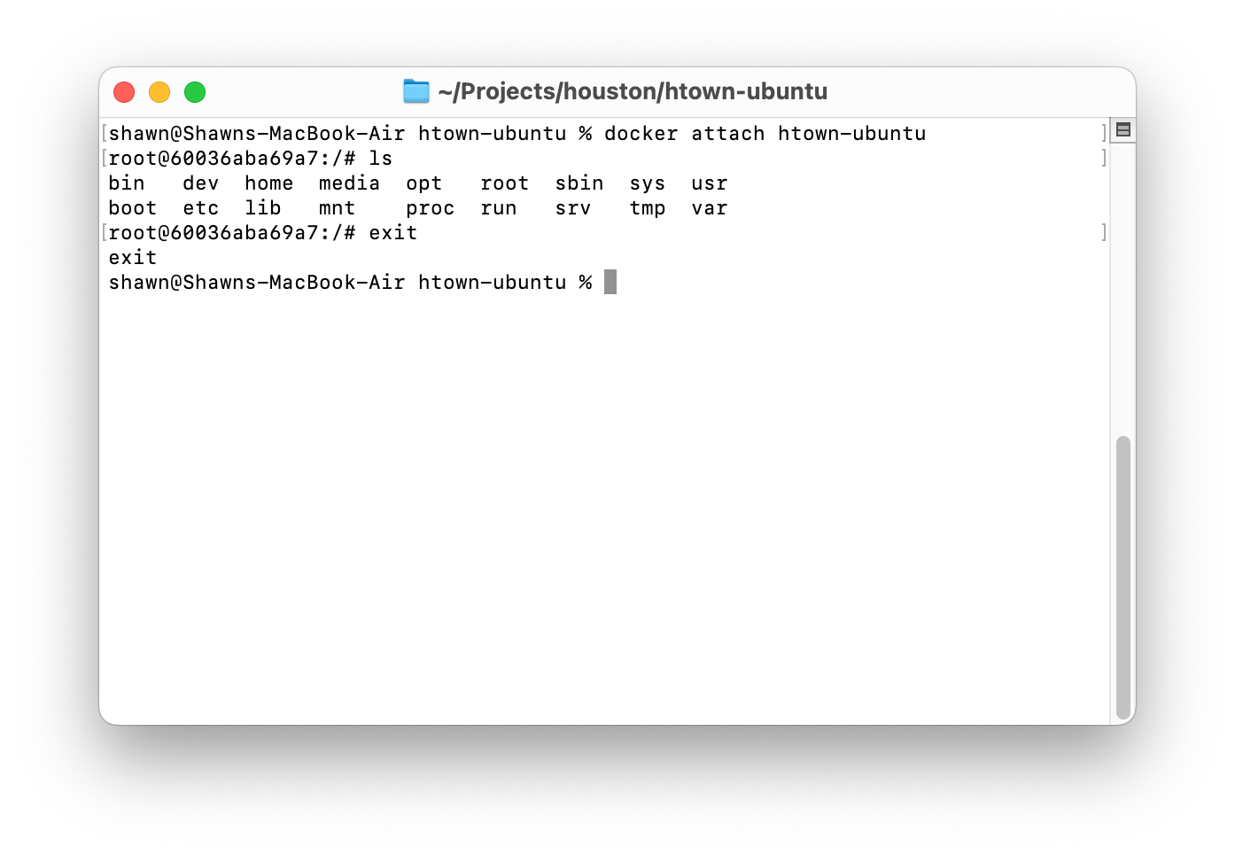
Containerization – Ubuntu Image – Connecting To
Having ubuntu running is boring. Let's connect to it and list the files then exit.
Connecting to Container
docker attach htown-ubuntu
Parameters
attach – attach std io to container
htown-ubuntu – name of container to attach to
Created by Shawn Zernik on 1/4/2024
Slide 65

Slide 66

Containerization – Ubuntu Image - Stopping
Finally, we’ll stop the container.
Stop Container
docker stop htown-ubuntu
Parameters
stop – action to perform on container
htown-ubuntu – name of container to act on
Created by Shawn Zernik on 1/4/2024
Slide 66

Slide 67
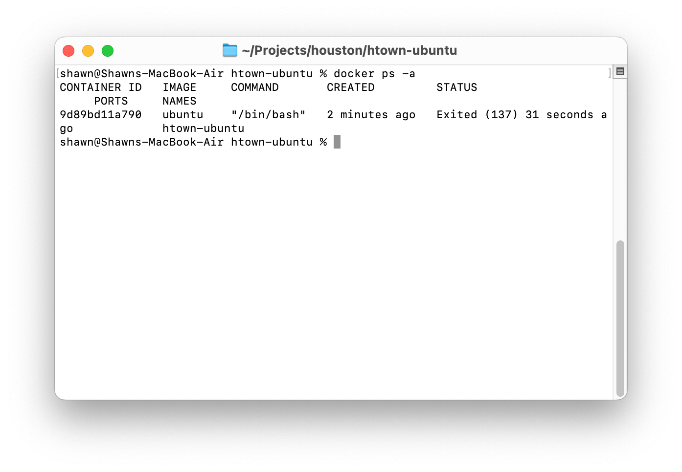
Containerization – Ubuntu Image – Listing All
Listing only the running containers gives you an incomplete view. We’ll often want to see all the containers, running or not.
List All Containers
docker ps -a
Parameters
ps – print status
-a – all, event not running
Created by Shawn Zernik on 1/4/2024
Slide 67

Slide 68

Containerization – Ubuntu Image - Deleting
When your done, delete the containers to free up space on your drive.
Delete Container
docker rm htown-ubuntu
Parameters
rm – delete action to perform on container
htown-ubuntu – name of container to act on
Created by Shawn Zernik on 1/4/2024
Slide 68

Slide 69
Containerization – Ubuntu Image – Final Note
As a final note, remember that the network your containers run in is not the same as the host operating systems. Running an ubuntu box on the same network as your containers is an awesome troubleshooting tool.
Finally, we will not list the commands to create, start, stop, delete, nor list containers in the next sections. We will focus on some specifics around the images we’ll be using.
Created by Shawn Zernik on 1/4/2024
Slide 69

Slide 70
Application Development with Kubernetes and AWS
Microsoft SQL Server
Or
Microsoft Azure SQL
Created by Shawn Zernik on 1/4/2024
Slide 70

Slide 71
Containerization – Azure SQL
This will create an instance of the Microsoft Azure SQL Edge server. Effectively, this is the Azure SQL server used in Microsoft’s cloud.
Microsoft Azure SQL
Running Microsoft SQL server on ARM processors gives a nice error. An alternative is to run the Microsoft Azure SQL. The command to create the container is as follows:
docker create \
-e "ACCEPT_EULA=Y" \
-e "MSSQL_SA_PASSWORD=Welcome123" \
-v "~/Projects/houston/htown-mssql/data":/var/opt/mssql/data \
-v "~/Projects/houston/htown-mssql/log":/var/opt/mssql/log \
-p 1433:1433 \
--network houston \
--name htown-mssql \
mcr.microsoft.com/azure-sql-edge
Parameters
-e – sets environment variables
  ACCEPT_EULA – accepts the license agreement
  MSSQL_SA_PASSWORD – set the password for the “sa” (admin) account
-p inside_port:outside_port – defines the port fordwarding rule to allow traffic from the “outside_port” into the containers “inside_port”.
Data Persistence
Stateful containers must have special care taken that the state is stored in/on some type of persistent storage.
Orchestration systems typically delete containers - so any data inside the container will be lost.
https://hub.docker.com/_/microsoft-azure-sql-edge
Created by Shawn Zernik on 1/4/2024
Slide 71

Slide 72
Containerization – Azure SQL
For a traditional Microsoft SQL server, we can use the follow. Note– this will not work on Mac’s with ARM processors.
Microsoft Azure SQL
Running Microsoft SQL server on ARM processors gives a nice error. An alternative is to run the Microsoft Azure SQL. The command to create the container is as follows:
docker create \
-e "ACCEPT_EULA=Y" \
-e "MSSQL_SA_PASSWORD=Welcome123" \
-e "MSSQL_PID=Developer"
-v "~/Projects/houston/htown-mssql/data":/var/opt/mssql/data \
-v "~/Projects/houston/htown-mssql/log":/var/opt/mssql/log \
-p 1433:1433 \
--network houston \
--name htown-mssql \
mcr.microsoft.com/mssql/server:2022-latest
Parameters
-e – sets environment variables
  ACCEPT_EULA – accepts the license agreement
  MSSQL_SA_PASSWORD – set the password for the “sa” (admin) account
  MSSQL_PID – the flavor of SQL server
    Developer
    Express
    Standard
    Enterprise
    EnterpriseCore
-p inside_port:outside_port – defines the port fordwarding rule to allow traffic from the “outside_port” into the containers “inside_port”.
Data Persistence
Stateful containers must have special care taken that the state is stored in/on some type of persistent storage.
Orchestration systems typically delete containers - so any data inside the container will be lost.
https://learn.microsoft.com/en-us/sql/linux/sql-server-linux-configure-environment-variables?view=sql-server-2017
Created by Shawn Zernik on 1/4/2024
Slide 72

Slide 73
Containerization – Developers
Postgres SQL
https://hub.docker.com/_/postgres
MySQL
https://hub.docker.com/_/mysql
MariaDB
https://hub.docker.com/_/mariadb
Mongo
https://hub.docker.com/_/mongo
RabbitMQ
https://hub.docker.com/_/rabbitmq
Redis
https://hub.docker.com/_/redis
DB2
https://hub.docker.com/r/ibmcom/db2
OracleDB
https://github.com/oracle/docker-images/tree/main/OracleDatabase/SingleInstance
SonarQube
https://hub.docker.com/_/sonarqube
Note to Developers
Rather than install database servers directly on your operating system, use containers. They install faster, start faster, use less space, and do not run 100% of the time – only when you start them. Practice with containers this way!
Created by Shawn Zernik on 1/4/2024
Slide 73

Slide 74
Application Development with Kubernetes and AWS
Custom Images
Created by Shawn Zernik on 1/4/2024
Slide 74

Slide 75
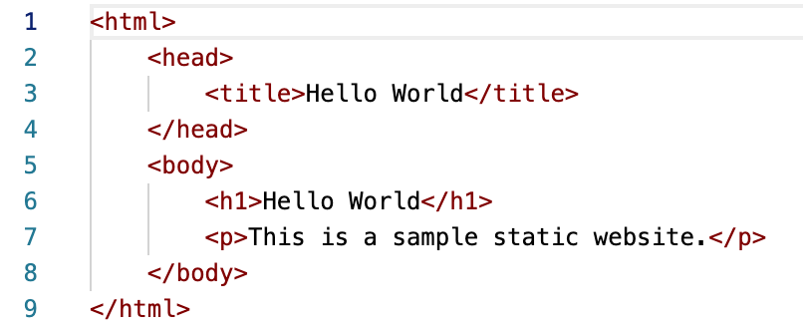
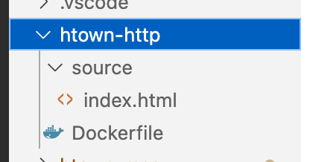
Containerization – Custom Images – Files Used
We’ll need to create a custom image to deploy our application – stock images will only get you so far. Being able to inject software, data, and content into images is critical for custom software. For demonstration purposes, we’ll create a ”hello world” website.
Created by Shawn Zernik on 1/4/2024
Slide 75

Slide 76
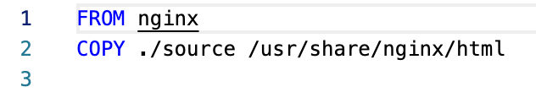
Containerization – Custom Images – Dockerfile
It does not get much simpler than this. We are starting with “nginx” image – a web server / proxy server. We will then copy “index.html” into the root of the website.
Created by Shawn Zernik on 1/4/2024
Slide 76

Slide 77
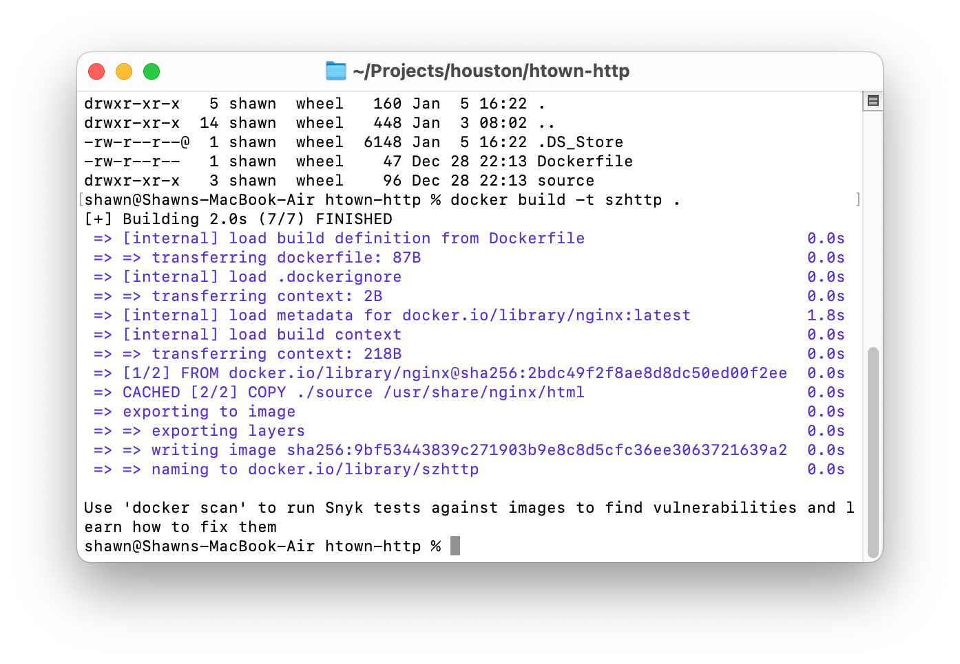
Containerization – Custom Images - Building
Now we need to build the container. When executing the “docker build” command, we need to have the current directory be the same location that has our ”Dockerfile”. In my instance, that’s “~/Projects/houston/htown-http”.
Build an Image
docker build –t szhttp .
Parameters
build – the action to take
-t – the “name:tage” to tag the image
. – the path to work from
Note the final dot on the command – this represents the current directory.
As another note, containers look for the file named “Dockerfile”. It has to be this name.
Output will list the images it downloaded, and actions taken. Once completed, you can create a container.
Created by Shawn Zernik on 1/4/2024
Slide 77

Slide 78
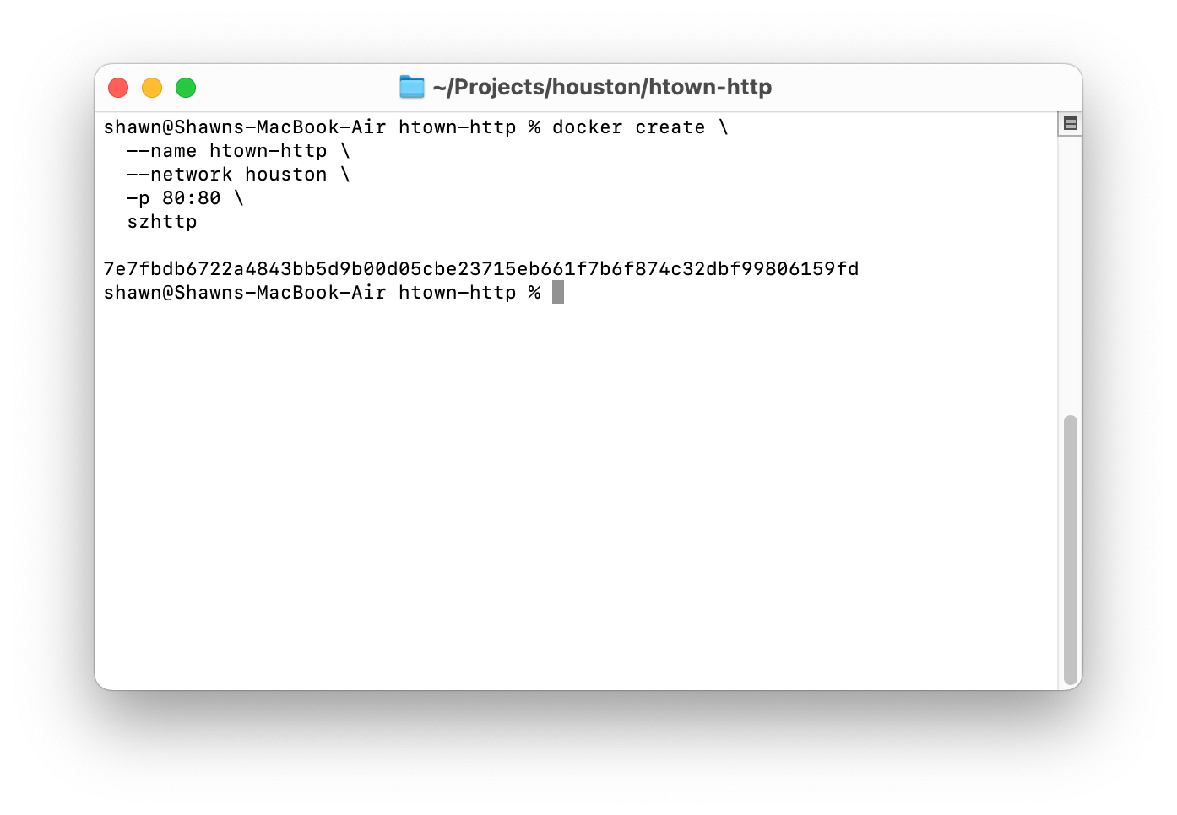
Containerization – Custom Images – Creating the Container
Now we need to build the container. When executing the “docker build” command, we need to have the current directory be the same location that has our ”Dockerfile”. In my instance, that’s “~/Projects/houston/htown-http”.
Create Container
docker create \
--name htown-http \
--network houston \
-p 80:80 \
szhttp
Parameters
In the prior “create container” we explained all the parameters used here.
Created by Shawn Zernik on 1/4/2024
Slide 78

Slide 79
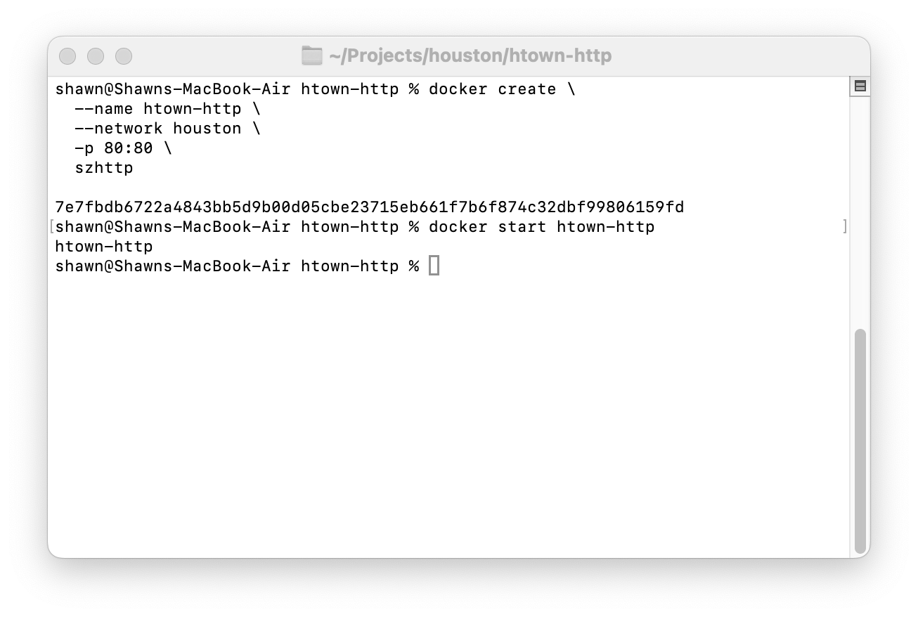
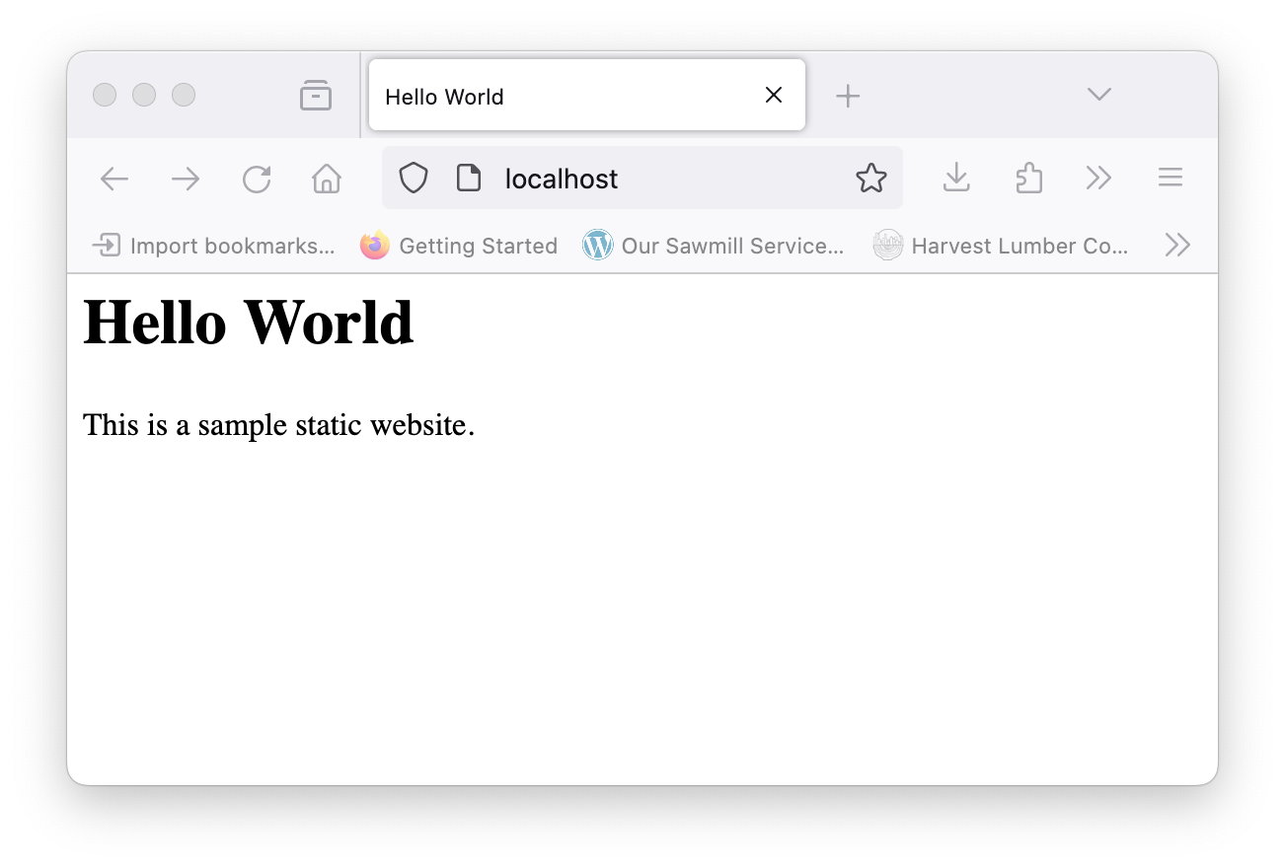
Containerization – Custom Images – Run and Test
Next we will need to start our container: “docker start htown-http”. We can then open our web browser the use the following URL: “http://localhost” and should see the web page.
Created by Shawn Zernik on 1/4/2024
Slide 79

Slide 80
Application Development with Kubernetes and AWS
Deploying DACPACs
Created by Shawn Zernik on 1/4/2024
Slide 80

Slide 81
Deploying DACPACs
Now that we have a Microsoft SQL Server or Azure SQL Server, we can deploy our DACPAC to the database server.
Make sure you have your database server running. Connect your database client:
SQL Server Management Studio – Windows Only
https://learn.microsoft.com/en-us/sql/ssms/download-sql-server-management-studio-ssms?view=sql-server-ver16
Azure Data Studio
https://azure.microsoft.com/en-us/products/data-studio
Dbeaver
https://dbeaver.io/
Created by Shawn Zernik on 1/4/2024
Slide 81

Slide 82
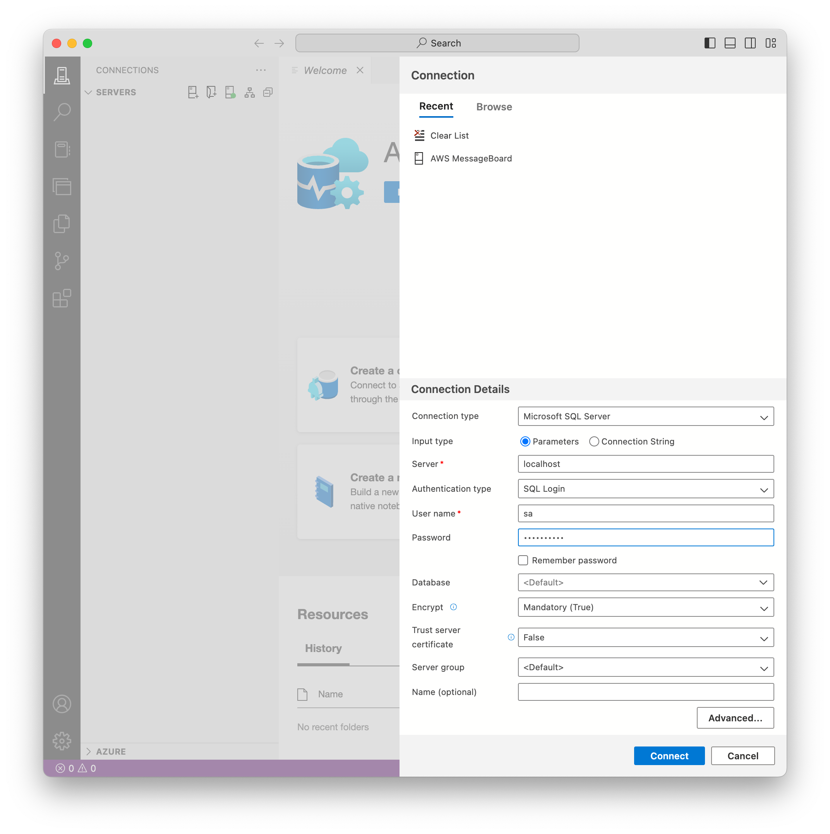
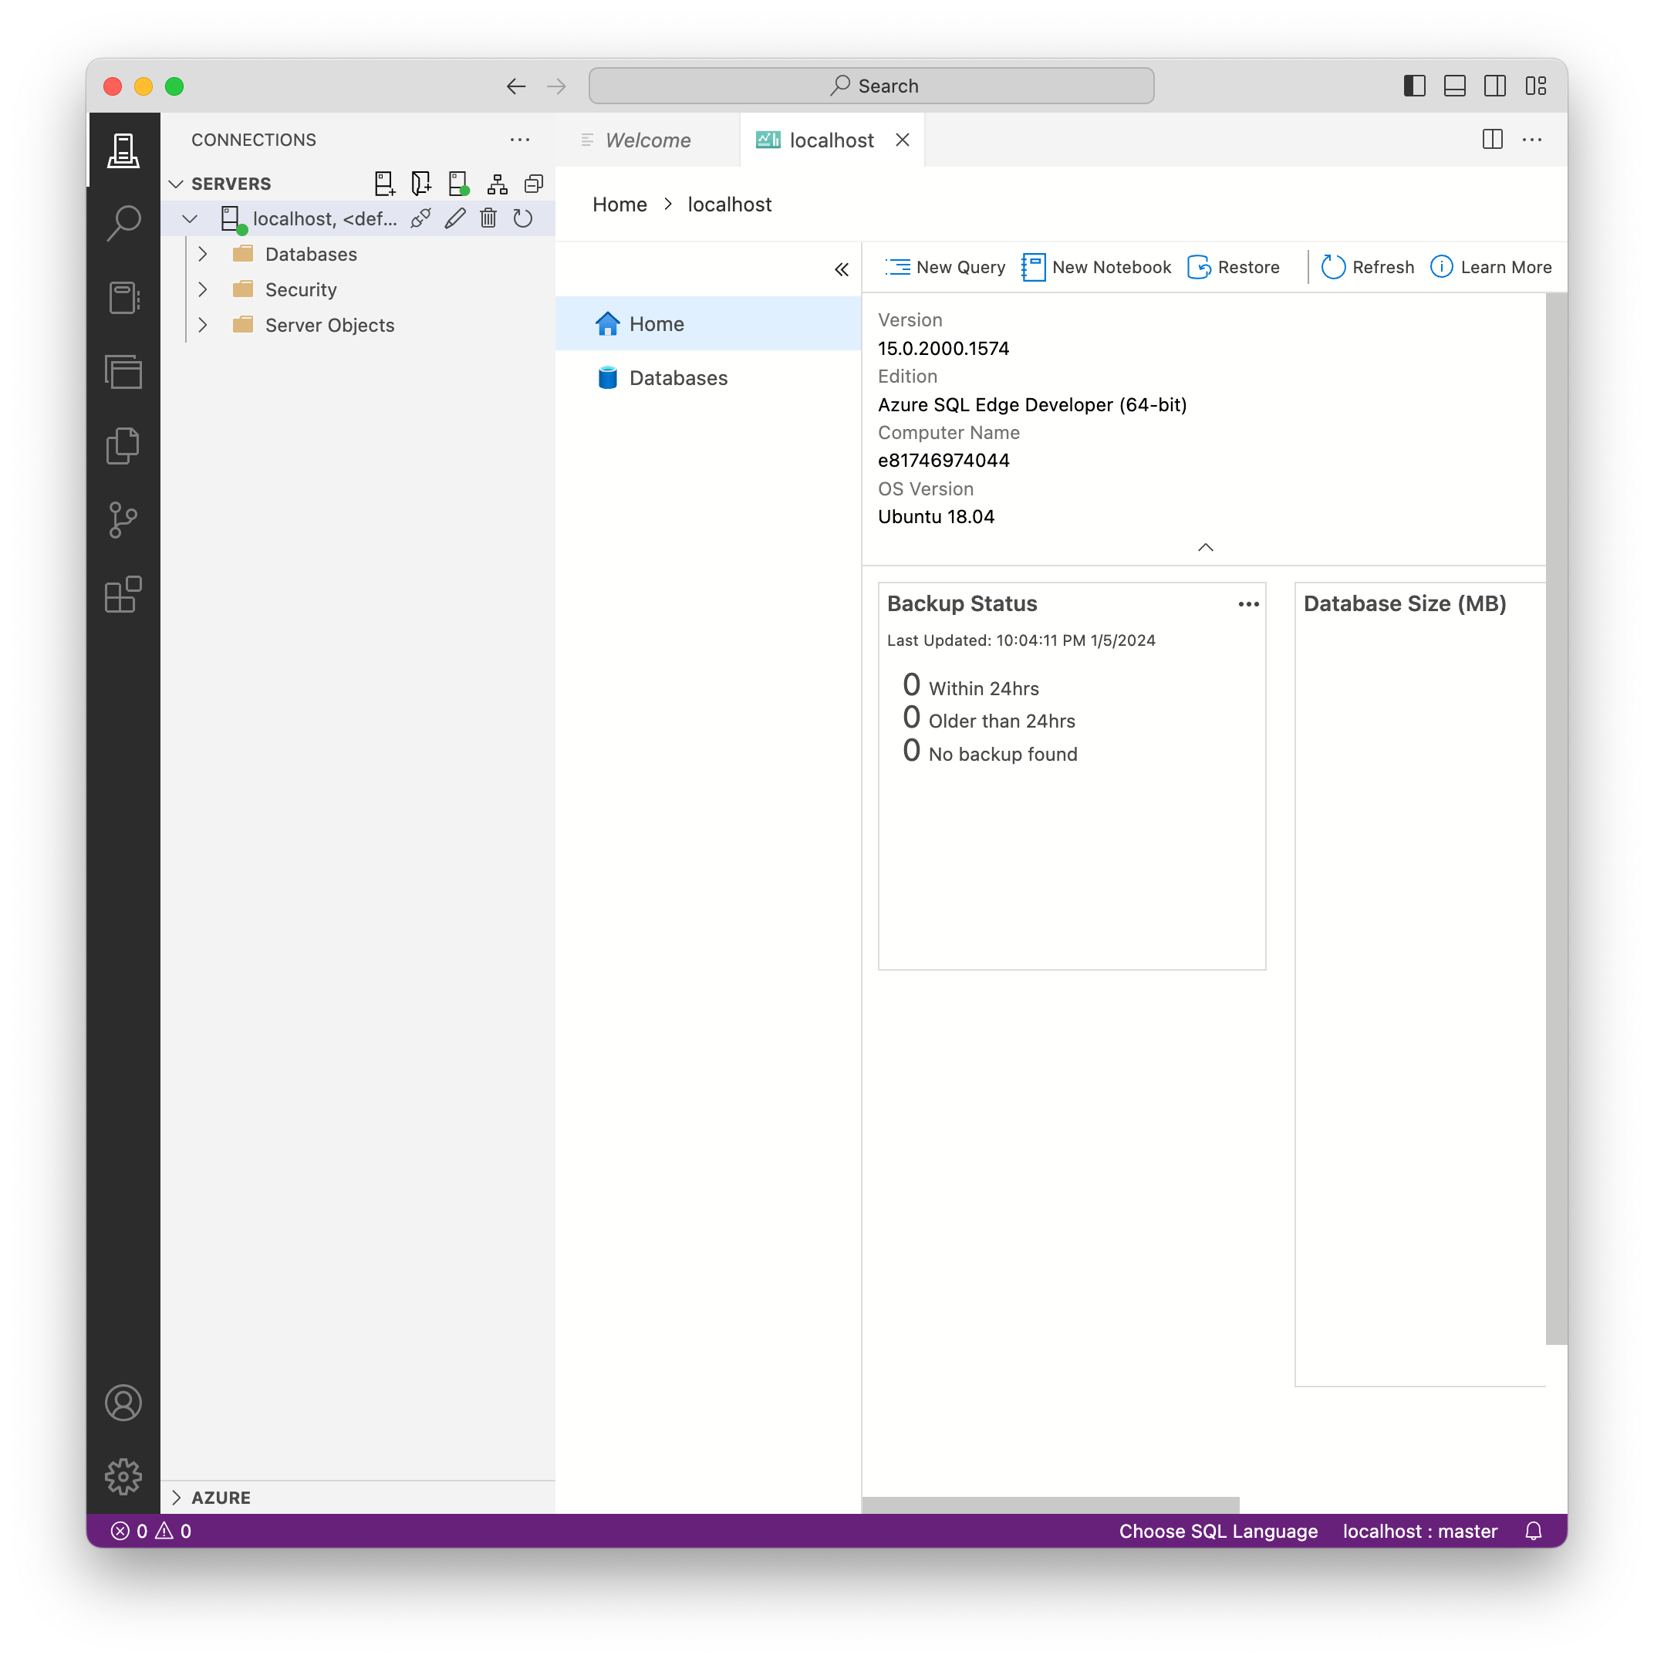
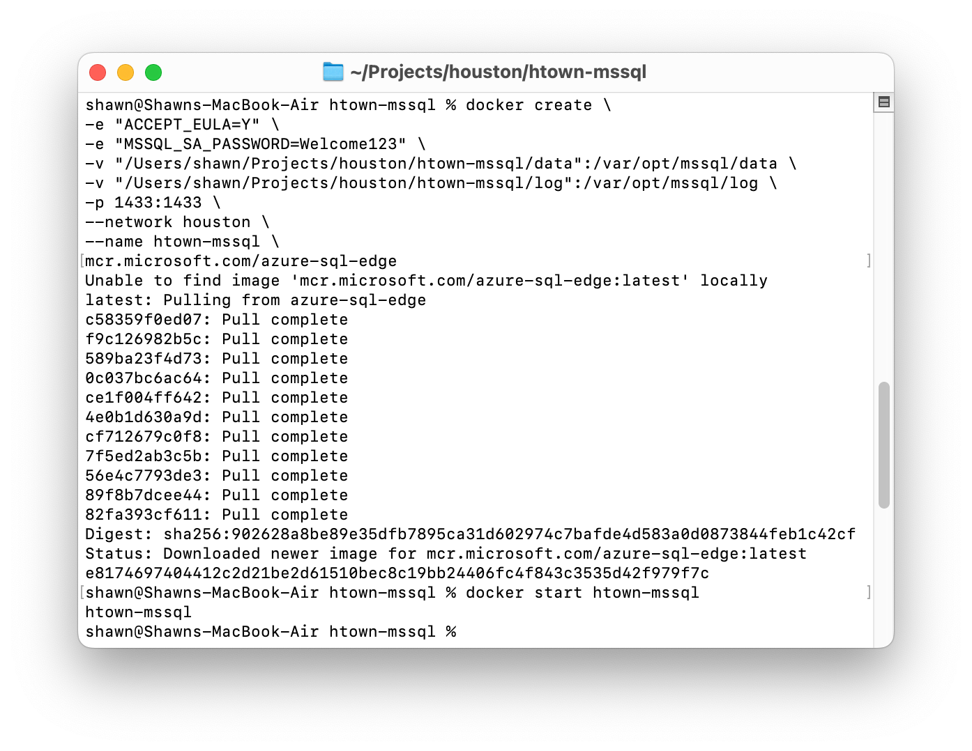
Deploying DACPACs – Validating Database Connectivity
From left to right, we created our SQL server, started it. I then opened Azure Data Studio and put in the connection details and clicked connect. It asked me to trust the server's certificate. Finally, I’m connected. We are ready to deploy the DACPAC now that I’ve verified database connectivity.
2
1
3
4
Created by Shawn Zernik on 1/4/2024
Slide 82

Slide 83
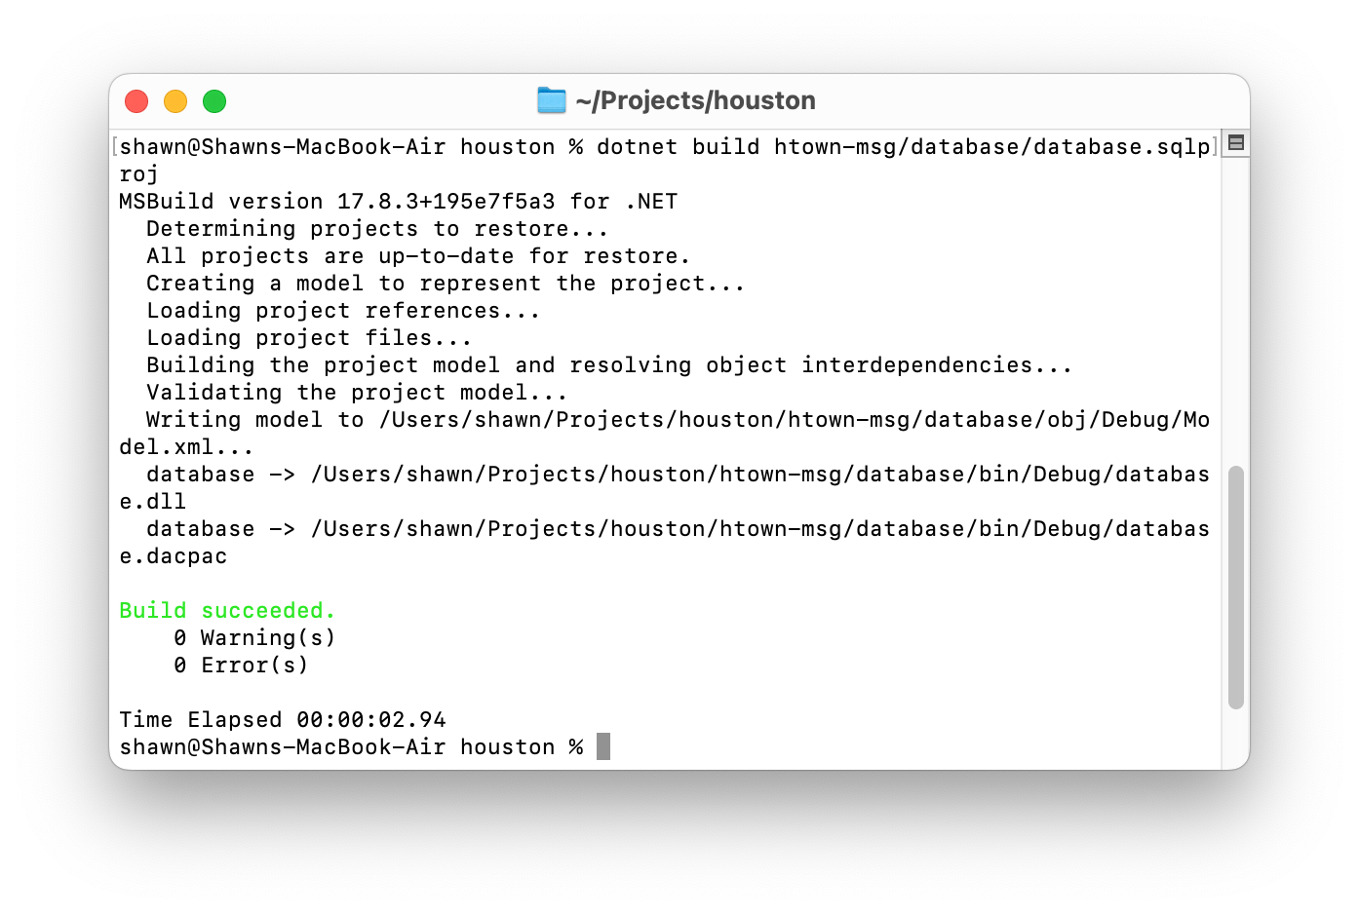
Deploying DACPACs – Build the DACPAC
Next, we’ll build our DACPAC from the DacFx project:
dotnet build htown-msg/database/database.sqlproj
Created by Shawn Zernik on 1/4/2024
Slide 83

Slide 84
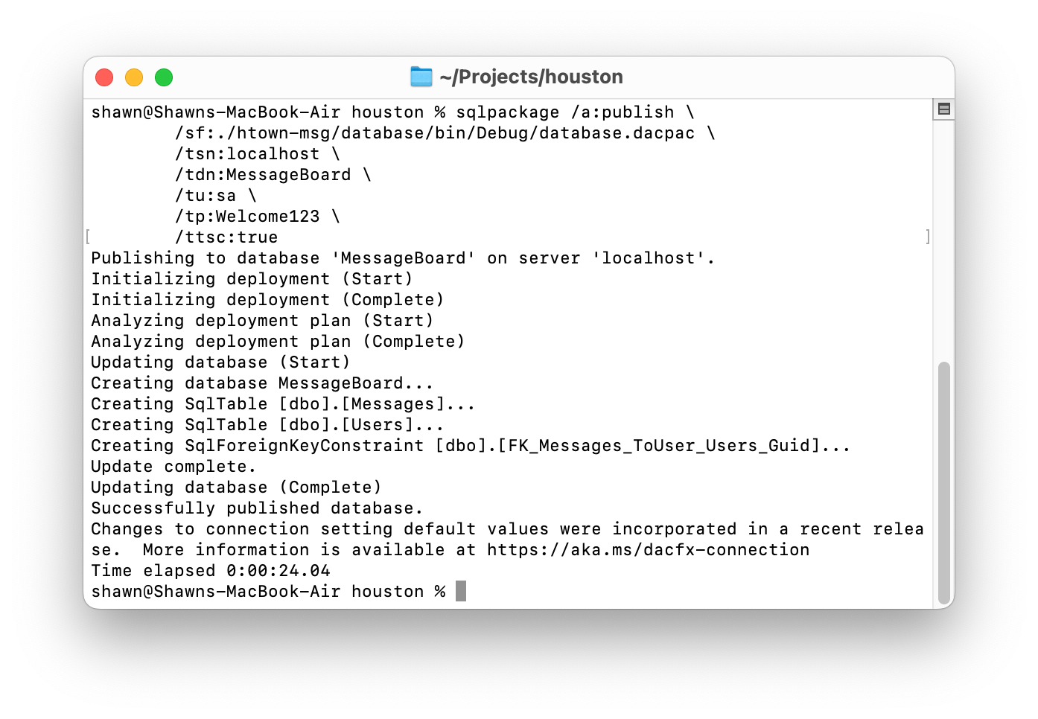
Deploying DACPACs – Publish DACPAC
Now we will publish the DACPAC to our database server:
sqlpackage \
/a:publish \
/sf:./htown-msg/database/bin/Debug/database.dacpac \
/tsn:localhost \
/tdn:MessageBoard \
/tu:sa \
/tp:Welcome123 \
/ttsc:true
Created by Shawn Zernik on 1/4/2024
Slide 84

Slide 85
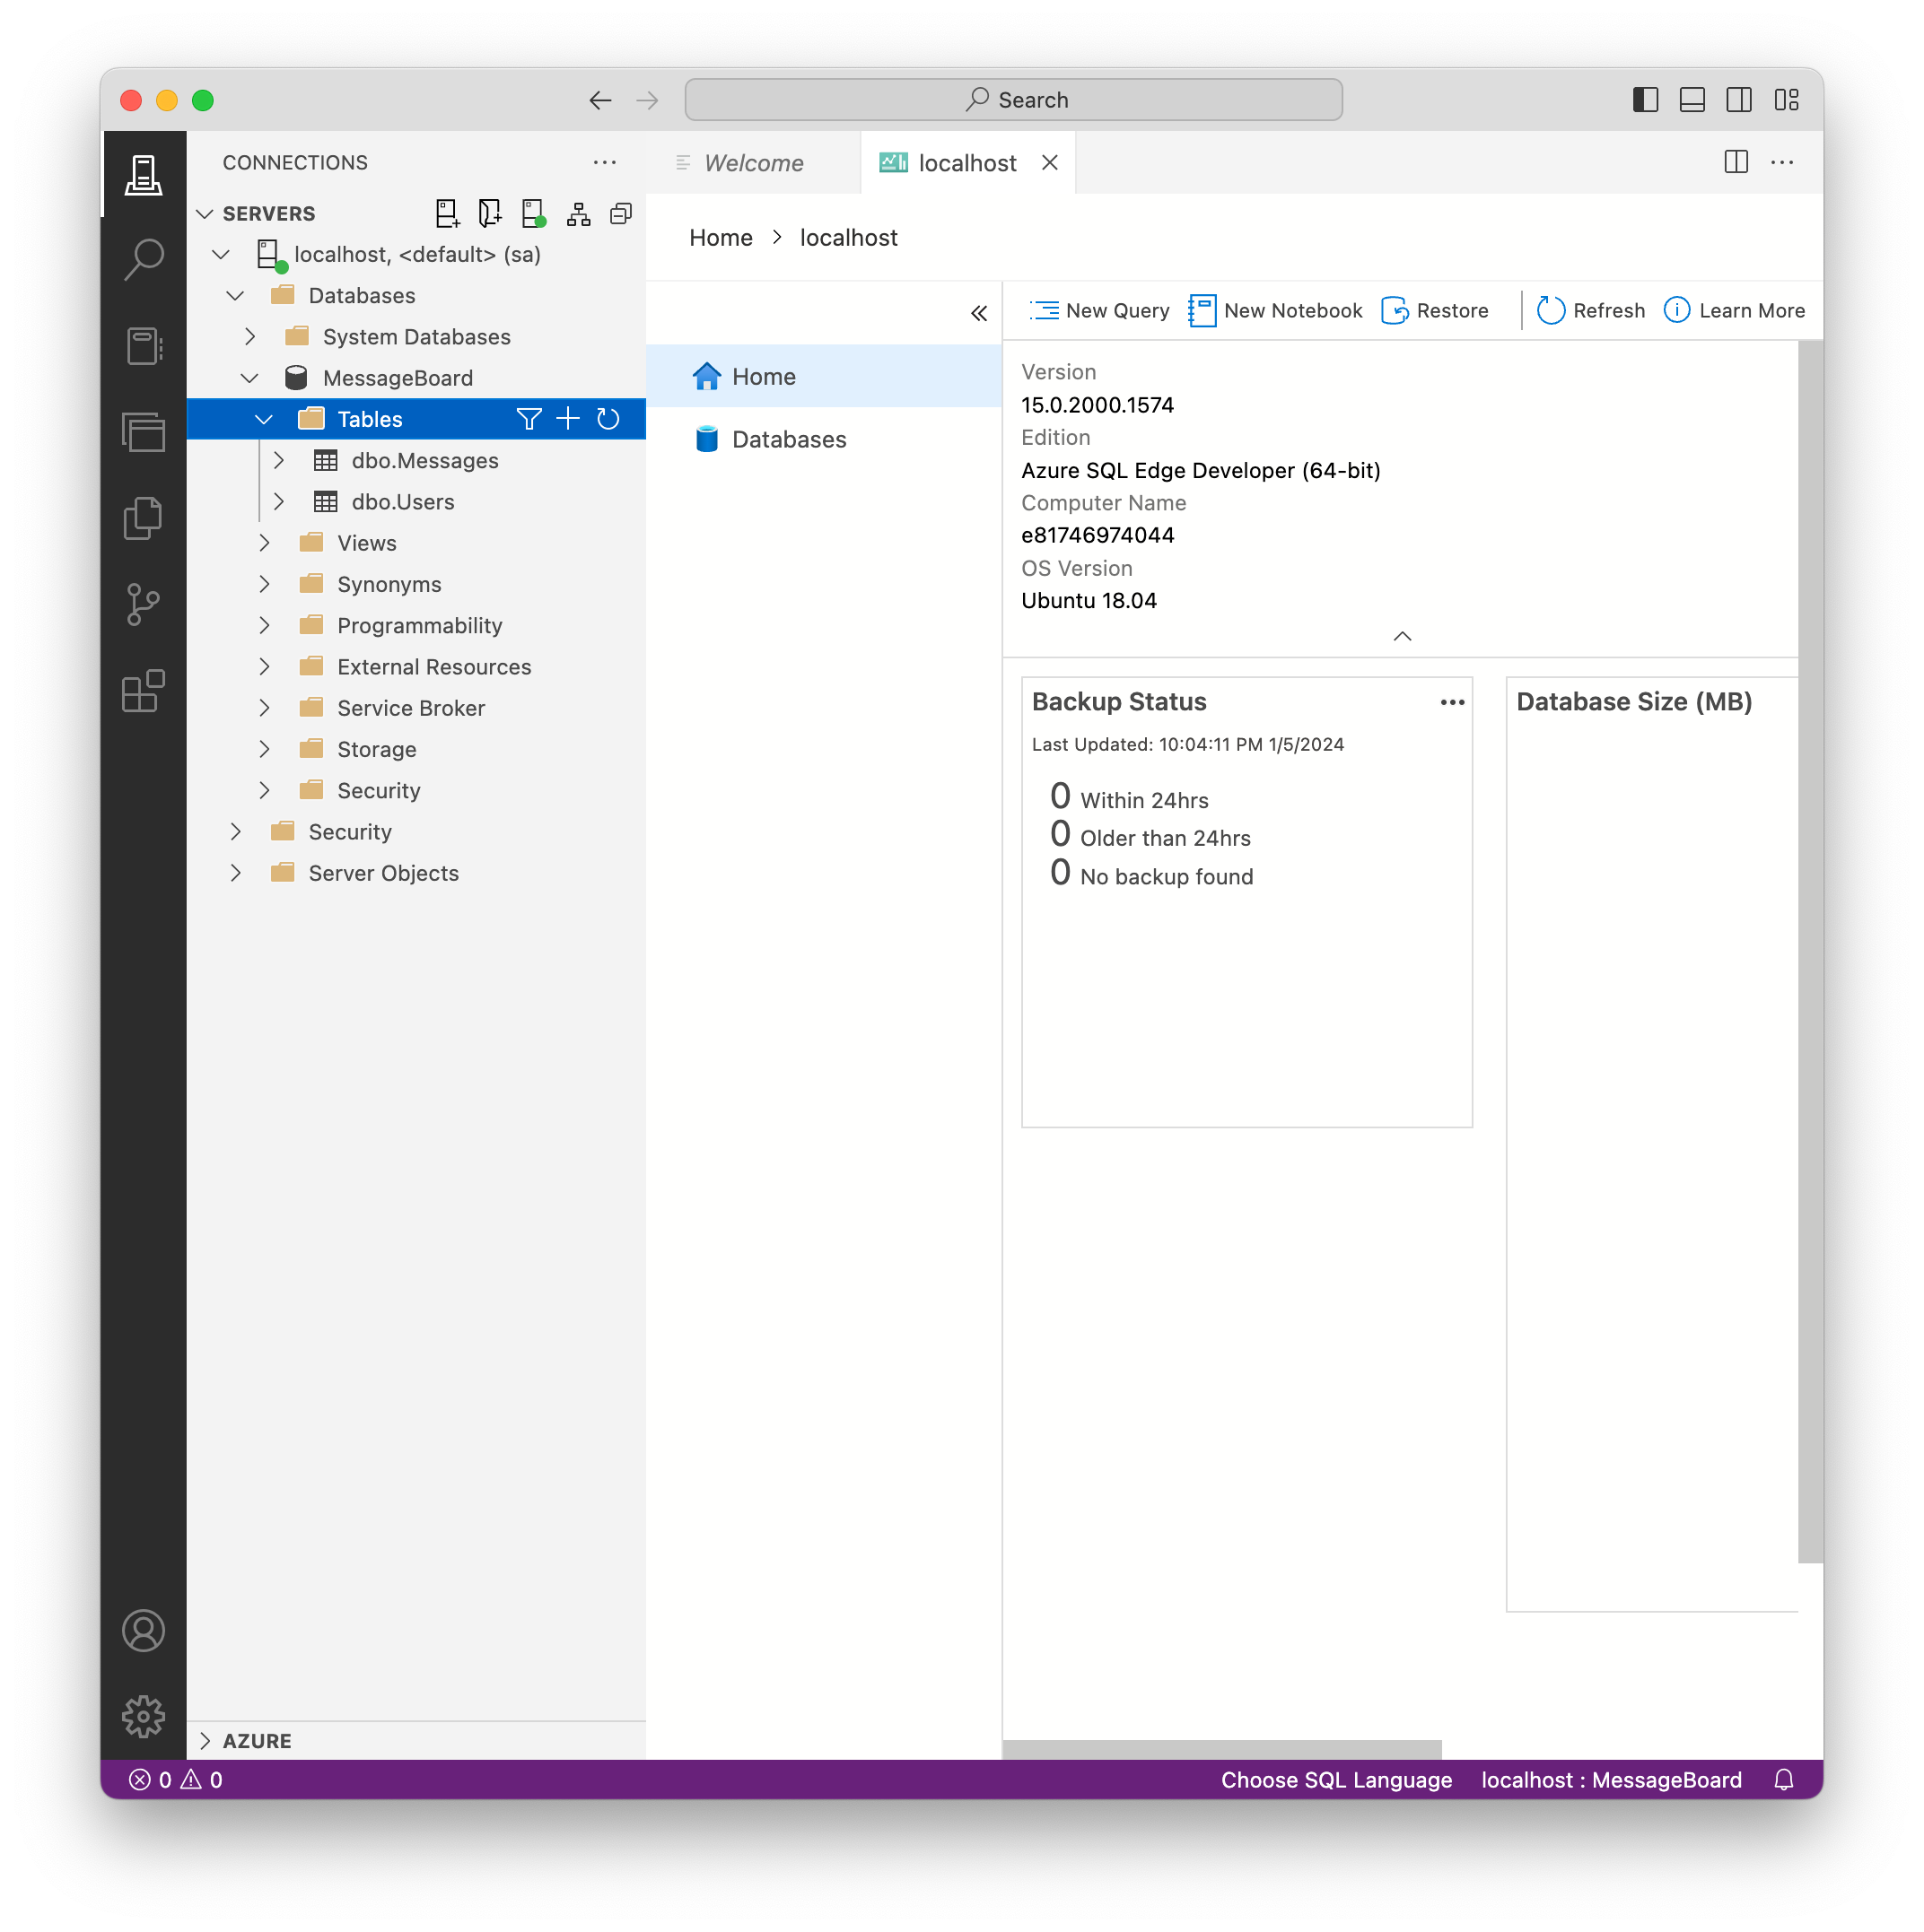
Deploying DACPACs – Validate Published
Finally, we’ll use our SQL client to validate the database and tables were created:
ALL GOOD!
Created by Shawn Zernik on 1/4/2024
Slide 85

Slide 86
Application Development with Kubernetes and AWS
Running Houston Message Board
Created by Shawn Zernik on 1/4/2024
Slide 86

Slide 87
Running Houston Message Board
Now that we have a database up validated, we can run Houston Message Board. We can do this one of two ways:
Thought VS Code and Debug
Having an environment that you can locally run the code and debug is critical.
Through the Command Line
Building and running an application on the command line is the next critical step to containerize. We need to know all the command and inputs to build our container.
Created by Shawn Zernik on 1/4/2024
Slide 87

Slide 88
Application Development with Kubernetes and AWS
1) Debugging in VS Code
Created by Shawn Zernik on 1/4/2024
Slide 88

Slide 89
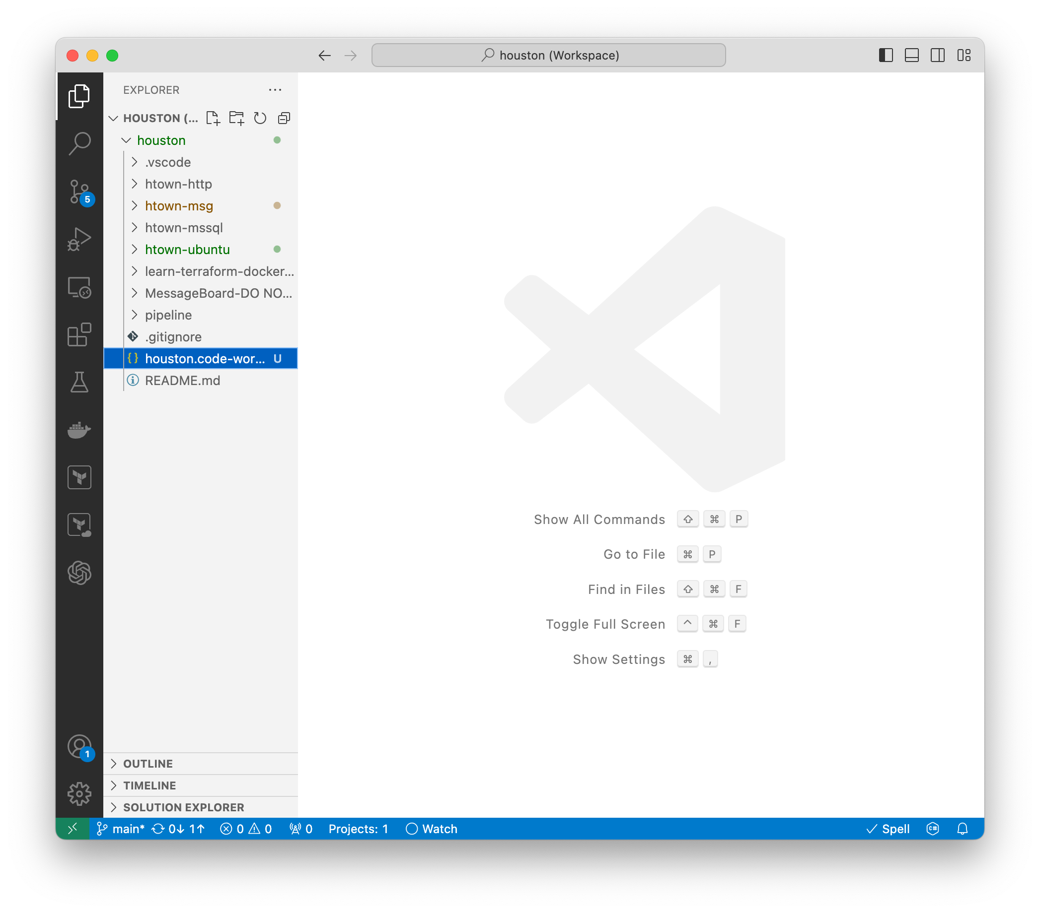
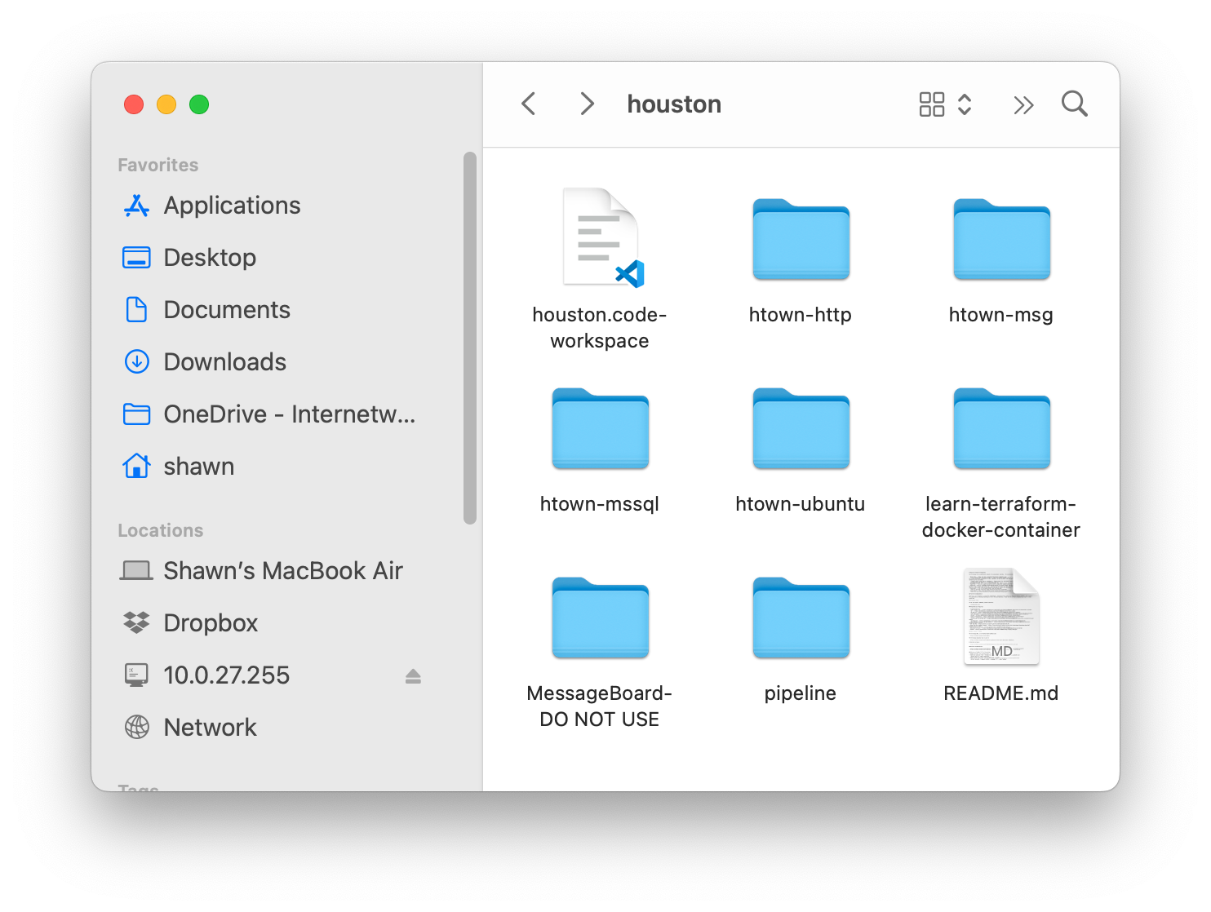
Running Houston Message Board – VS Code – Workspace
In the repository root, there is a “houston.code-workspace” file. Use this to open Visual Studio Code.
Always use a workspace file. When making changes to your IDE, coding styles, capitalization, lint settings, etc, you have the option to save these setting in the workspace file: do so. That way everyone on the team can operate on the same settings.
Created by Shawn Zernik on 1/4/2024
Slide 89

Slide 90
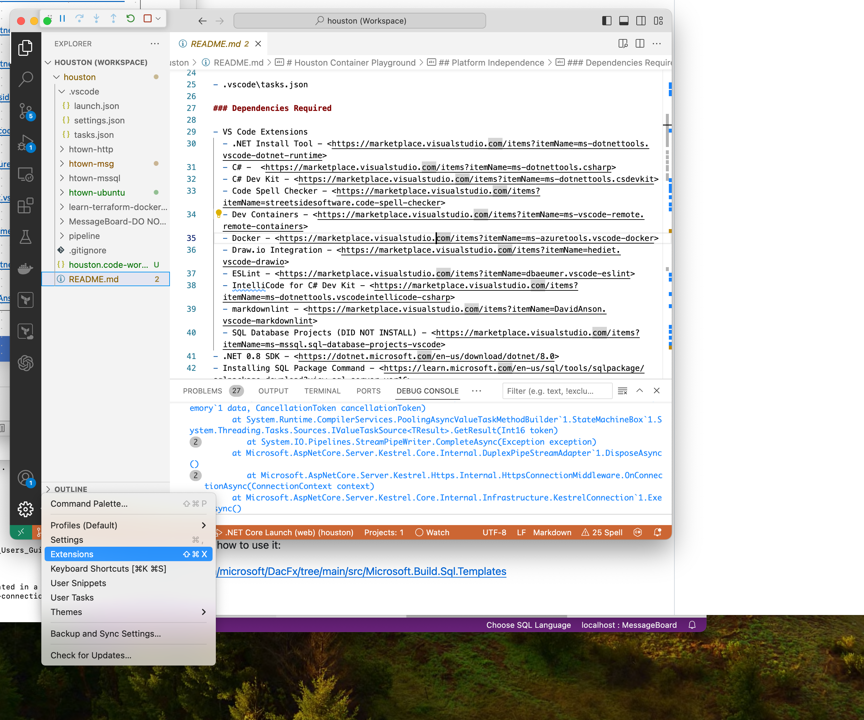
Running Houston Message Board – VS Code – Extensions
VS Code has a plethora of extensions, and you’ll want to install some. Below is a list of extension I’ve installed.
VS Code Extensions .NET Install Tool
https://marketplace.visualstudio.com/items?itemName=ms-dotnettools.vscode-dotnet-runtime
C#
https://marketplace.visualstudio.com/items?itemName=ms-dotnettools.csharp
C# Dev Kit
https://marketplace.visualstudio.com/items?itemName=ms-dotnettools.csdevkit
Code Spell Checker
https://marketplace.visualstudio.com/items?itemName=streetsidesoftware.code-spell-checker
Dev Containers
https://marketplace.visualstudio.com/items?itemName=ms-vscode-remote.remote-containers
Docker
https://marketplace.visualstudio.com/items?itemName=ms-azuretools.vscode-docker
Draw.io Integration
https://marketplace.visualstudio.com/items?itemName=hediet.vscode-drawio
ESLint
https://marketplace.visualstudio.com/items?itemName=dbaeumer.vscode-eslint
IntelliCode for C# Dev Kit
https://marketplace.visualstudio.com/items?itemName=ms-dotnettools.vscodeintellicode-csharp
Markdownlint
https://marketplace.visualstudio.com/items?itemName=DavidAnson.vscode-markdownlint
Created by Shawn Zernik on 1/4/2024
Slide 90

Slide 91
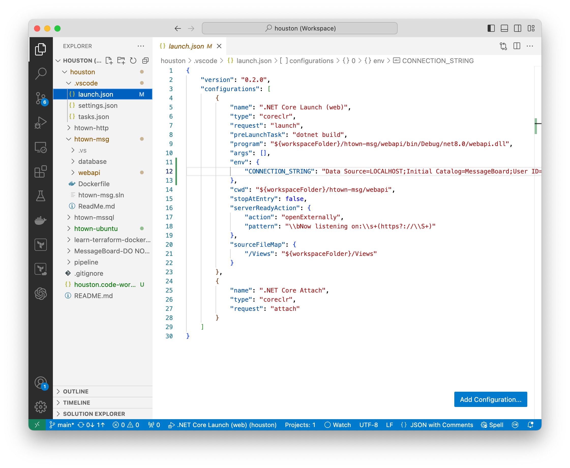
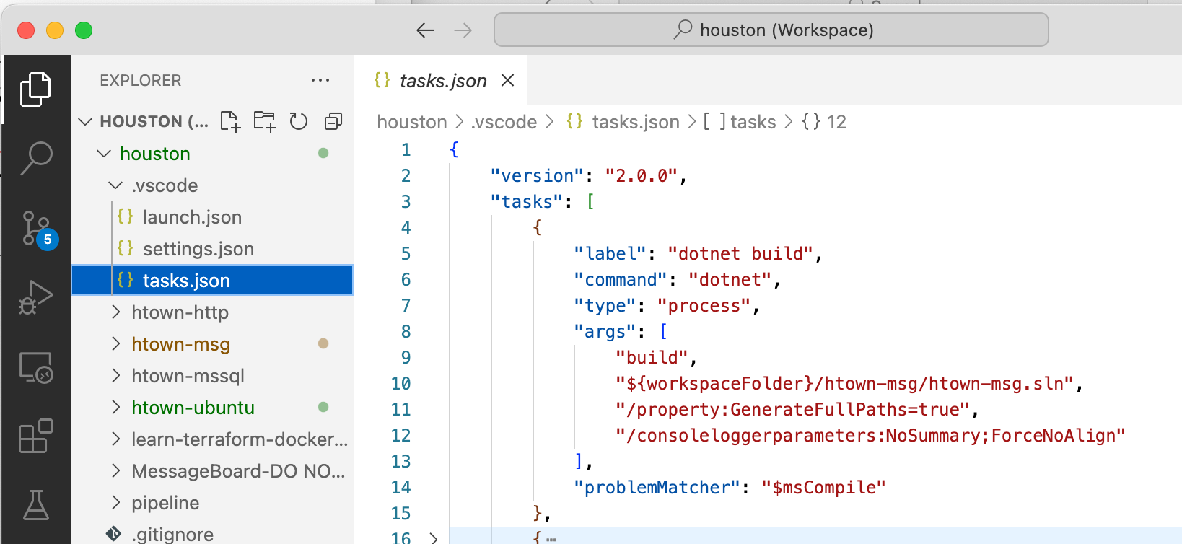
Running Houston Message Board – VS Code – Launch
In the files, there is a “.vscode” folder and a “launch.json” file. This “launch.json” file has the command and settings to run and debug the application. This also references the “build” task to be completed before running / debugging.
The “dotnet build” tasks is defined in the “tasks.json” in the “.vscode” folder. This tells VS Code how to build the application.
Created by Shawn Zernik on 1/4/2024
Slide 91

Slide 92
Running Houston Message Board – VS Code – Launch
We can configure the environment variable for the DB connection string.
Created by Shawn Zernik on 1/4/2024
Slide 92

Slide 93
Running Houston Message Board – VS Code – Launch
This is what should be ran once the build is completed.
For more details on debugging, read the documentation:
https://code.visualstudio.com/docs/editor/debugging
Created by Shawn Zernik on 1/4/2024
Slide 93

Slide 94
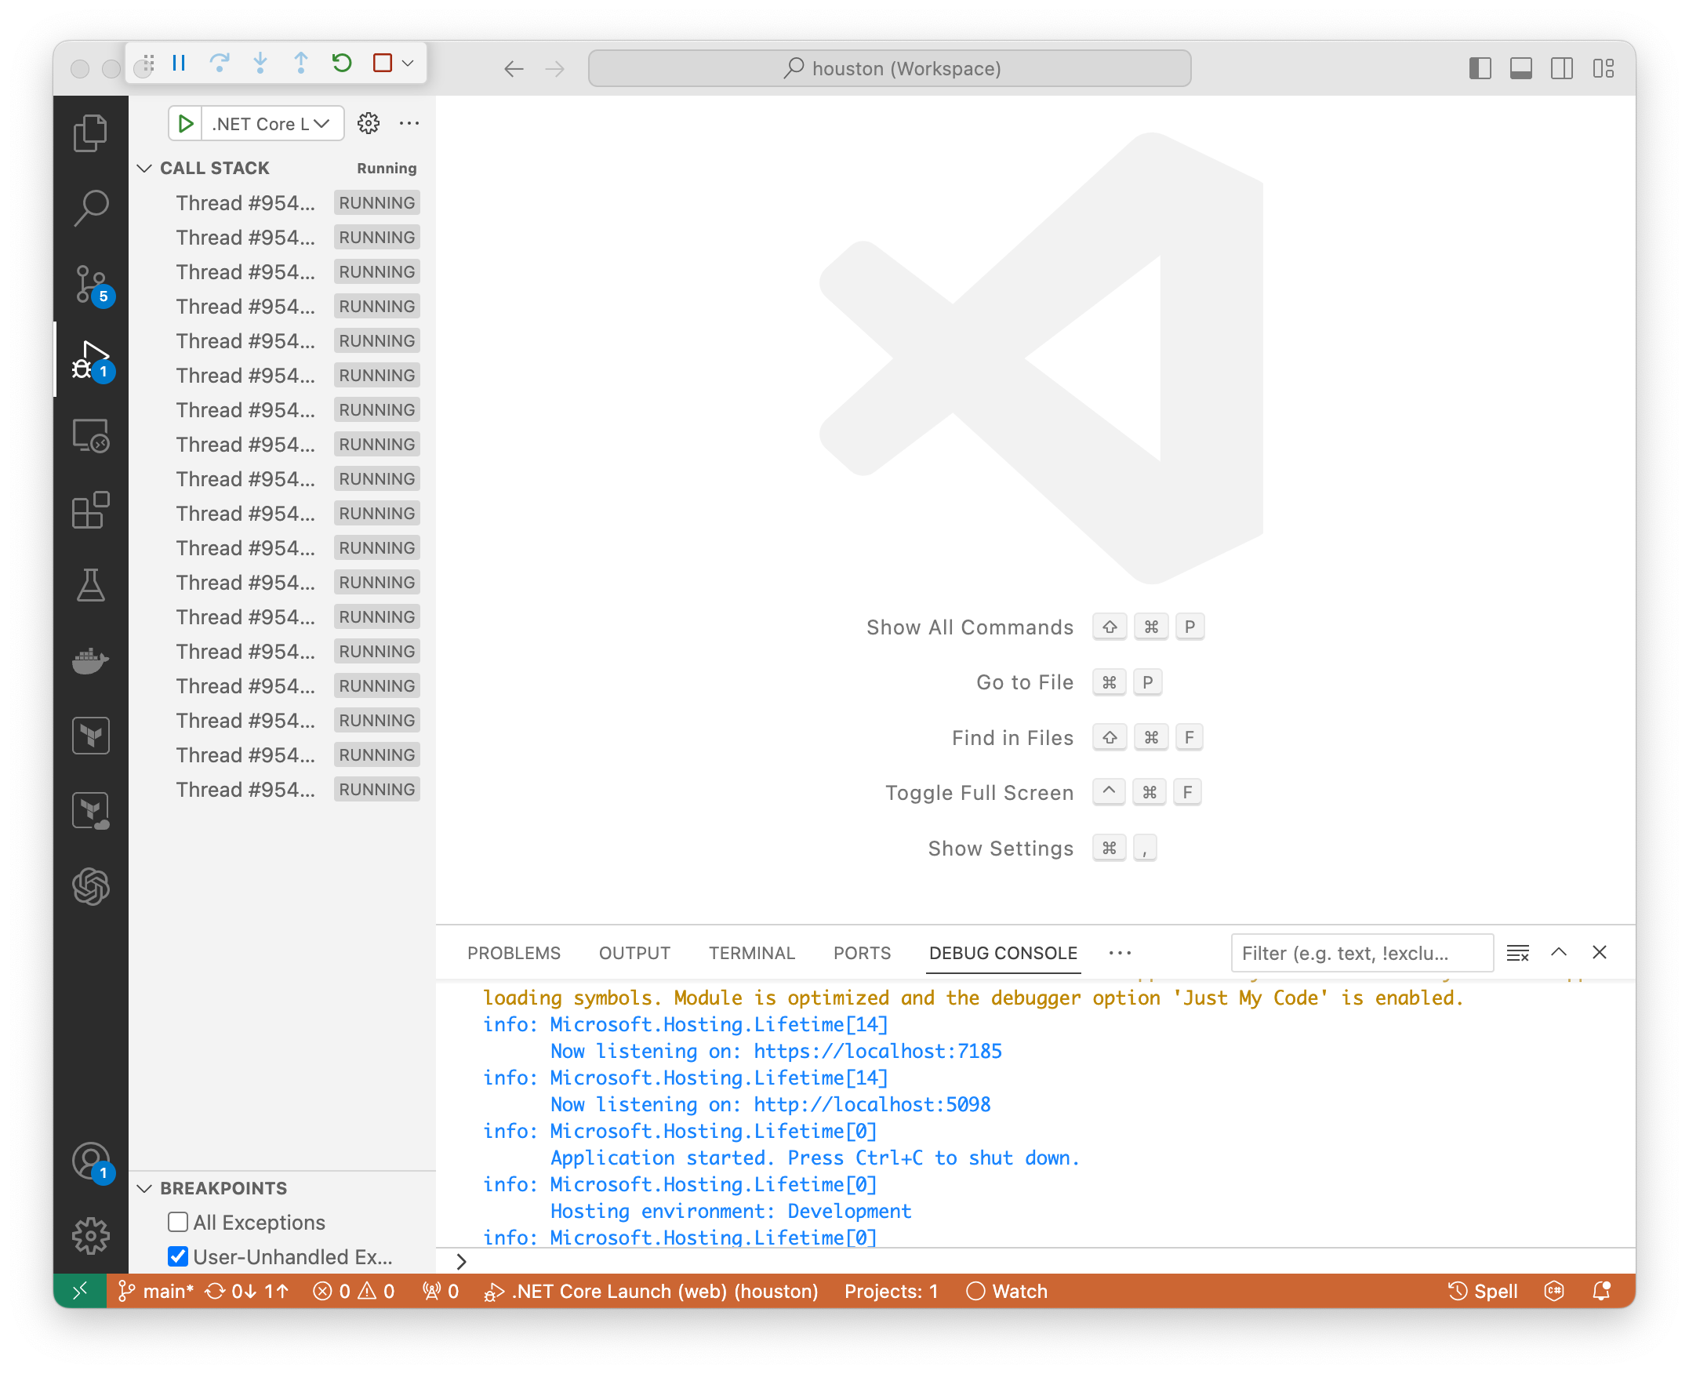
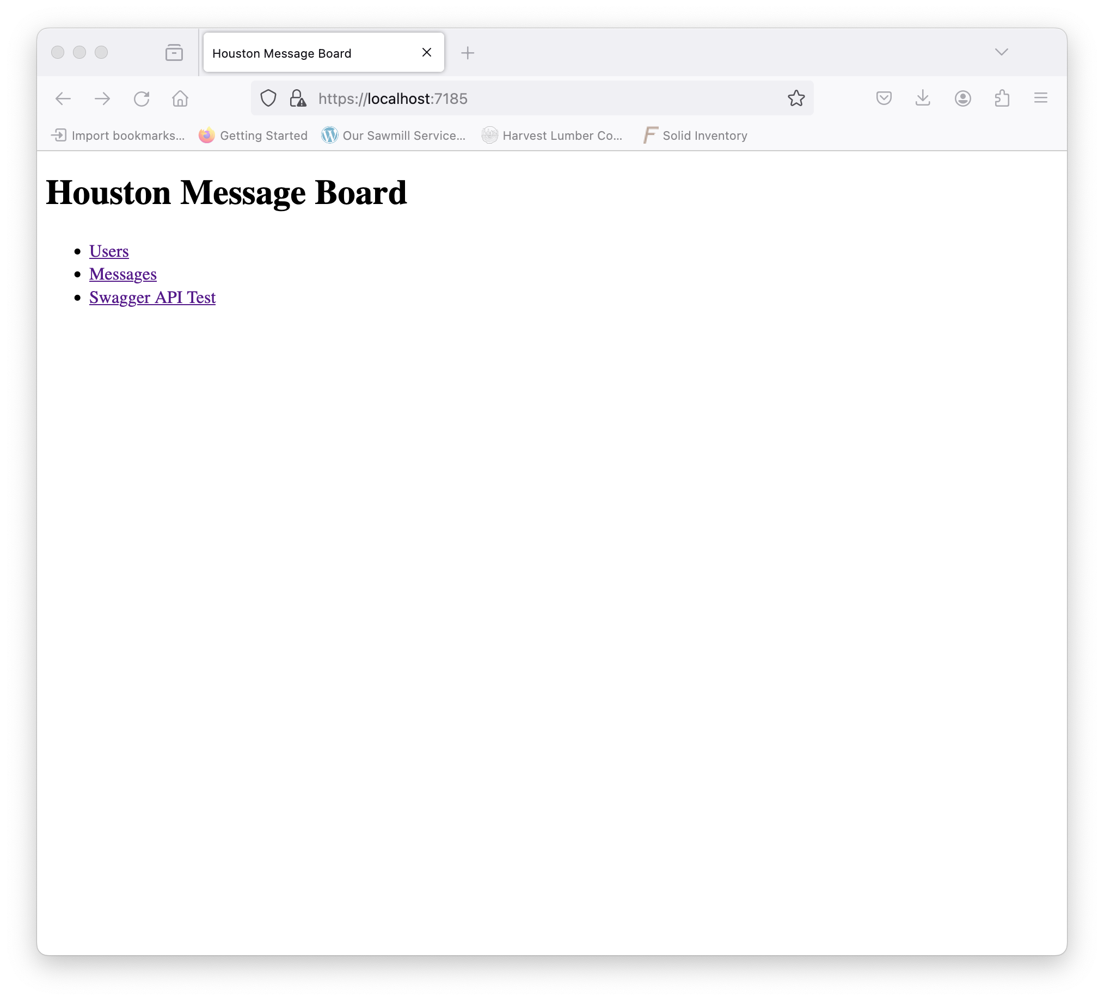
Running Houston Message Board – VS Code – Launch
4
2
1
Go to the “debug” button on the right
Click the play button
The “Debug Console” will populate with build and output
The web browser will open to the site.
3
Created by Shawn Zernik on 1/4/2024
Slide 94

Slide 95
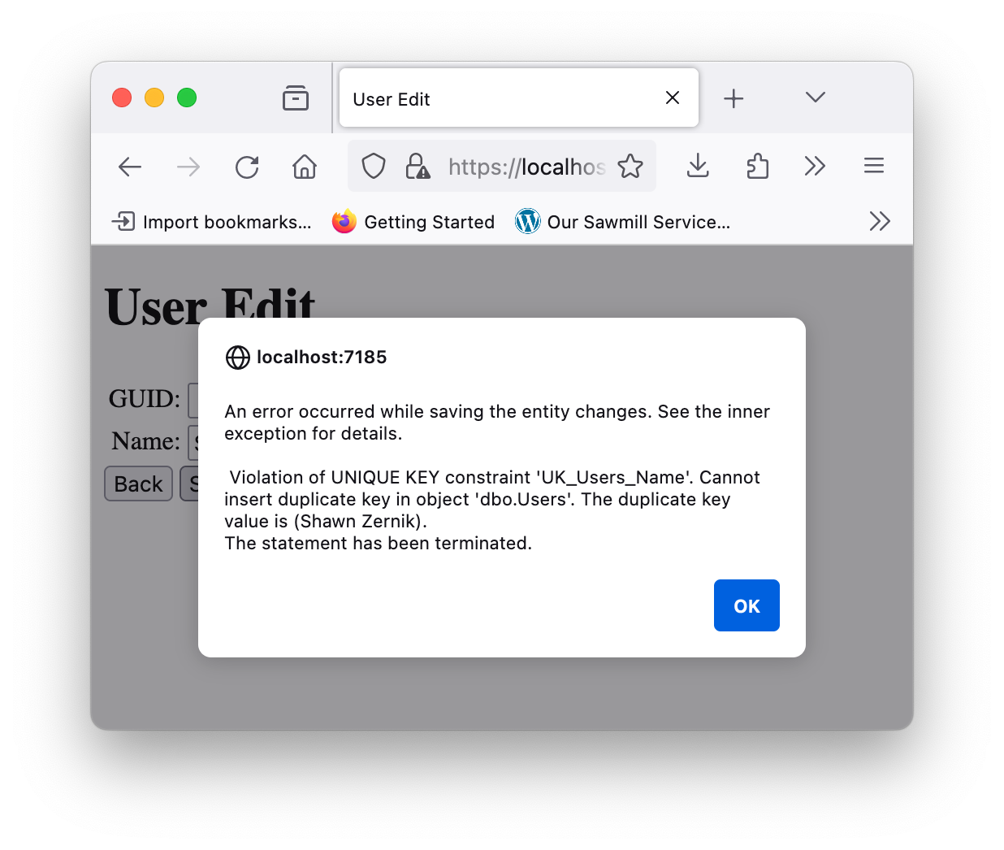
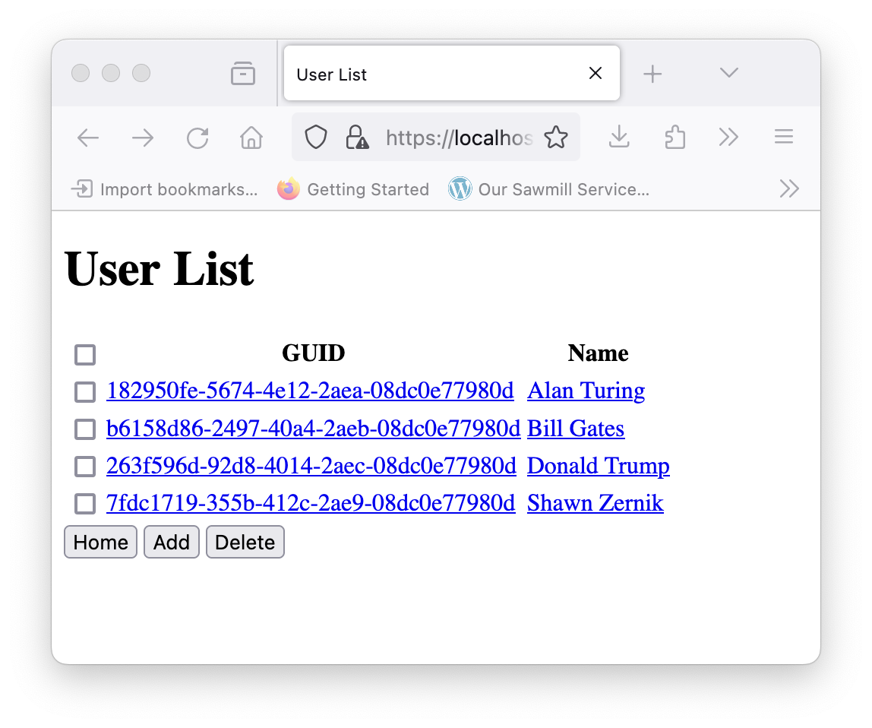
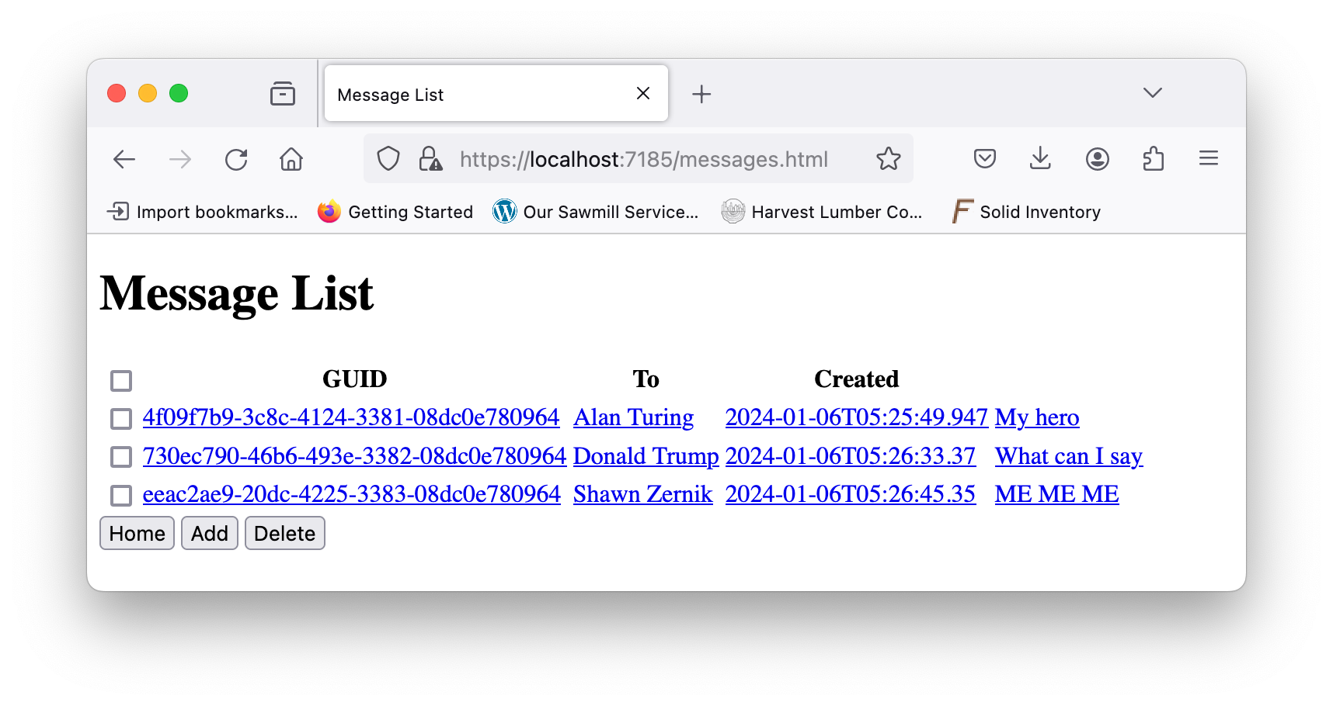
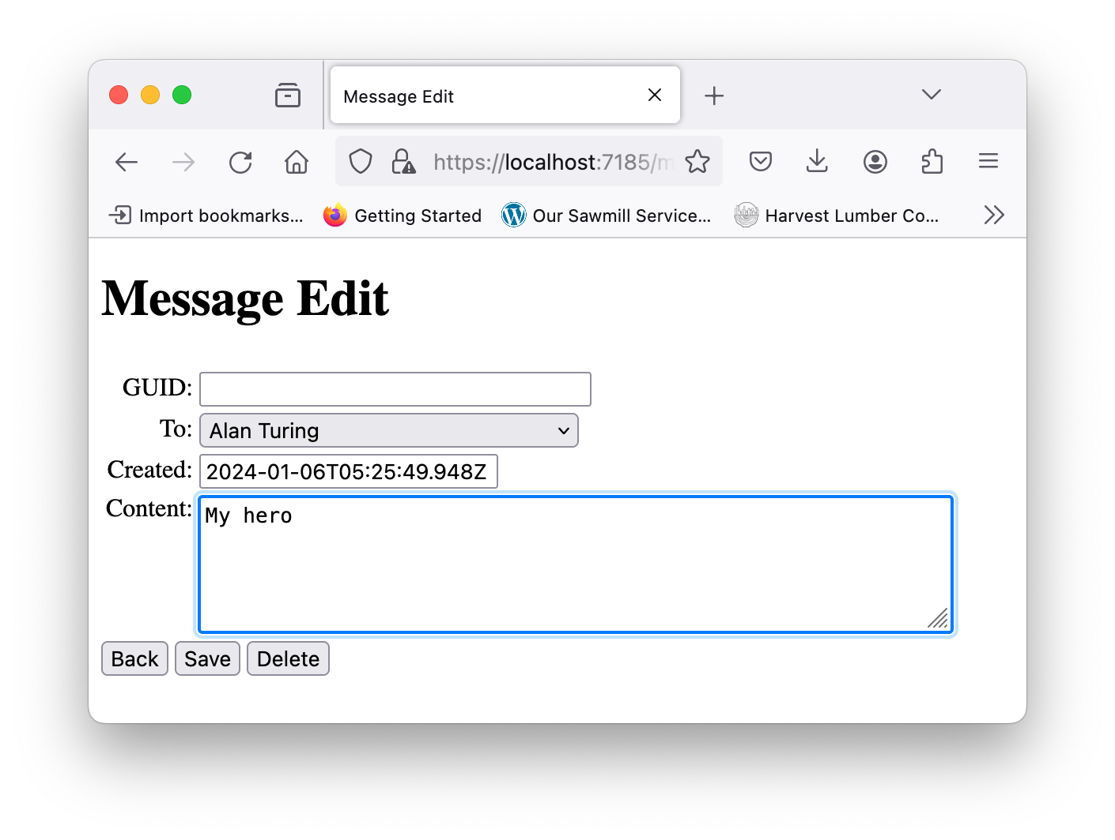
Running Houston Message Board – VS Code – Test & Debug
Play with the app.
Do CRUD (create, read, update, delete) on each of the tables.
Create a duplicate user.
Delete a foreign key.
Add some breakpoints.
Created by Shawn Zernik on 1/4/2024
Slide 95

Slide 96
Application Development with Kubernetes and AWS
2) Running from Command Prompt
Created by Shawn Zernik on 1/4/2024
Slide 96

Slide 97
Running Houston Message Board – Running at Command Prompt
Before we can attempt to build our image and container for the application, we need to understand how to build it at the command prompt. In DotNet Core, the commands will look as follows:
Restore Nuget Packages
This will pull in all the dependencies defined by the application. This includes OpenApi, Swagger, Entity Framework, and Logging.
Build Application
Building the application will create the “webapi” executable that includes the DotNet Core ASP WebApplication. This will put the files in the “bin\debug” folder but will not include the static content.
Publish Application
Publishing the app will put the executables and static content in one folder. This is where we want to run everything.
Created by Shawn Zernik on 1/4/2024
Slide 97

Slide 98

Running Houston Message Board – Running at Command Prompt – Restore NuGet
Run the following command to clean and restore the NuGet packages:
dotnet clean ./htown-msg/webapi/webapi.csproj
dotnet restore ./htown-msg/webapi/webapi.csproj
Created by Shawn Zernik on 1/4/2024
Slide 98

Slide 99

Running Houston Message Board – Running at Command Prompt – Build
Build the executables:
dotnet build ./htown-msg/webapi/webapi.csproj -c Release
Created by Shawn Zernik on 1/4/2024
Slide 99

Slide 100

Running Houston Message Board – Running at Command Prompt – Publish
Publish the web application:
dotnet publish ./htown-msg/webapi/webapi.csproj -c Release
Make note of the published folder.
Let's go look there next.
Created by Shawn Zernik on 1/4/2024
Slide 100

Slide 101

Running Houston Message Board – Running at Command Prompt – Inspect
Inspect the published folder:
cd ./htown-msg/webapi/bin/Release/net8.0/publish/
ls
Created by Shawn Zernik on 1/4/2024
Slide 101

Slide 102
Running Houston Message Board – Running at Command Prompt – Inspect
Inspect the published folder:
The binary executable.
Created by Shawn Zernik on 1/4/2024
Slide 102

Slide 103
Running Houston Message Board – Running at Command Prompt – Inspect
Inspect the published folder:
Static content.
Created by Shawn Zernik on 1/4/2024
Slide 103

Slide 104
Running Houston Message Board – Running at Command Prompt – Inspect
Inspect the published folder:
Dependencies.
Created by Shawn Zernik on 1/4/2024
Slide 104

Slide 105
Running Houston Message Board – Running at Command Prompt – Inspect
Inspect the published folder:
Configs
Created by Shawn Zernik on 1/4/2024
Slide 105

Slide 106
Running Houston Message Board – Running at Command Prompt – Inspect
Inspect the published folder:
Debug details.
This is used when exceptions are thrown to create a call stack with file name and line numbers.
Created by Shawn Zernik on 1/4/2024
Slide 106

Slide 107



Running Houston Message Board – Running at Command Prompt – Run It!
Run the application:
It works! But wait, I didn’t set the environment variable for the connection string.
Created by Shawn Zernik on 1/4/2024
Slide 107

Slide 108

Running Houston Message Board – Running at Command Prompt – Summary
Notice our logging gives us good output, and the error message is meaningful.
While we forgot to configure the database connection string, everything worked as expected.
We will call this a success and move on to containerization of the web app.
I’ll leave it to you to figure out the connection string in the environment variable.
Created by Shawn Zernik on 1/4/2024
Slide 108

